Slide 1
Coupledline Compiled Data
Individually calibrated sampler gains.

Slide 2
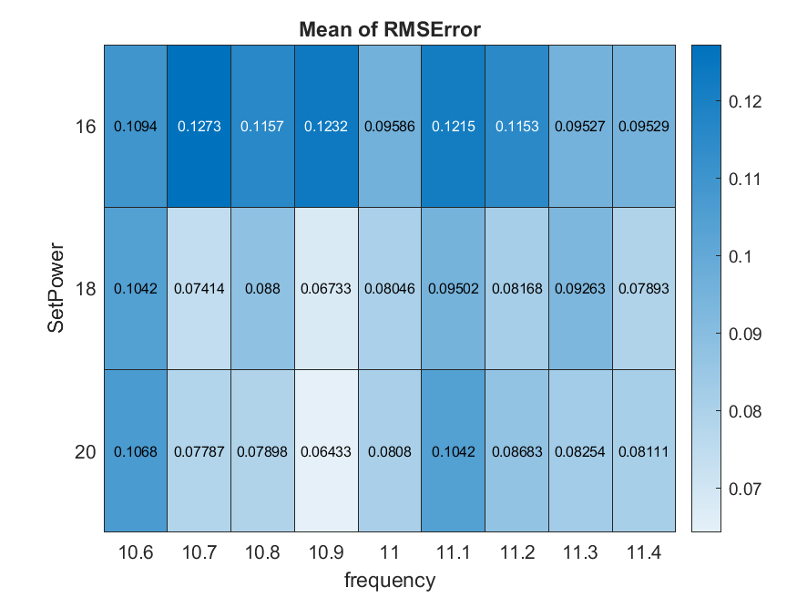
Bias 1

Slide 3
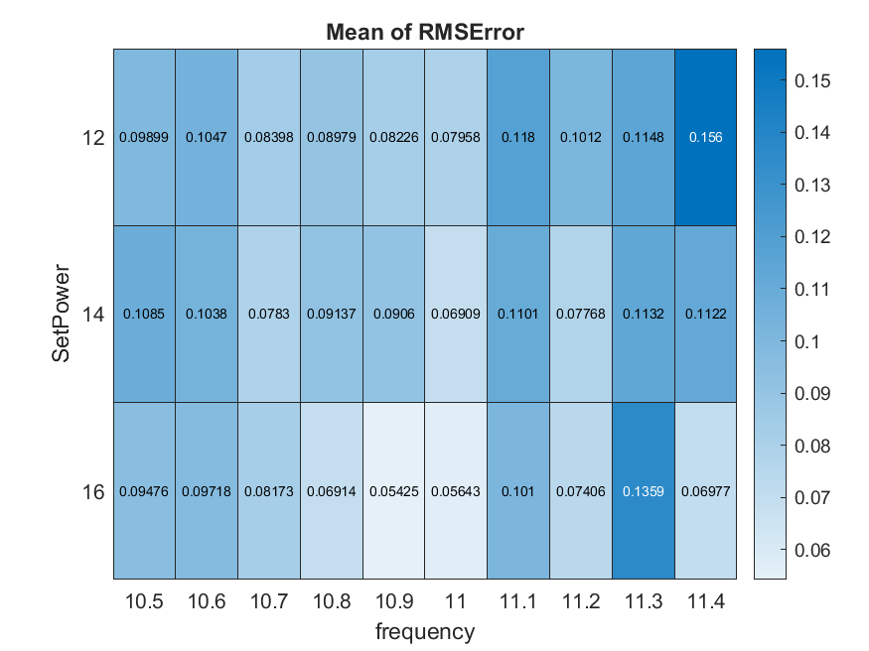
Bias 2

Slide 4
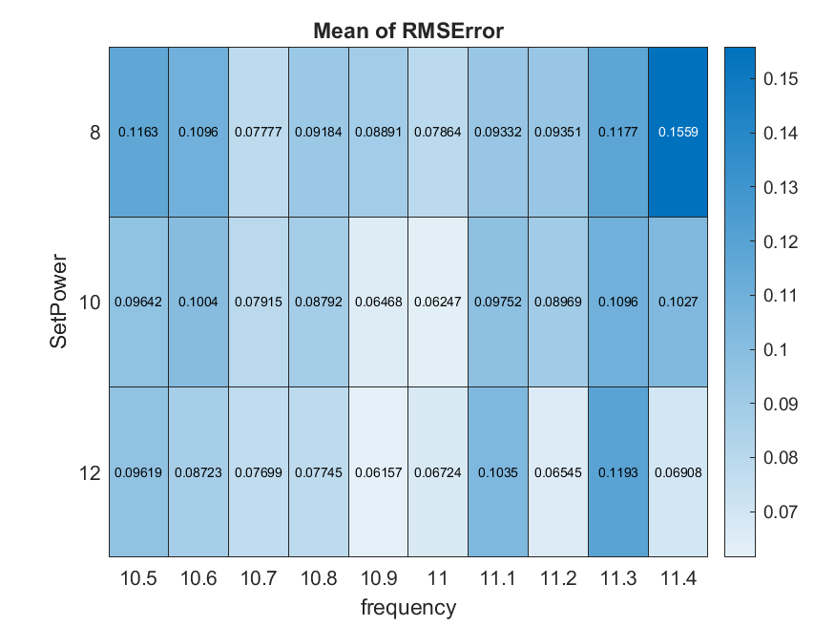
Bias 3

Slide 5
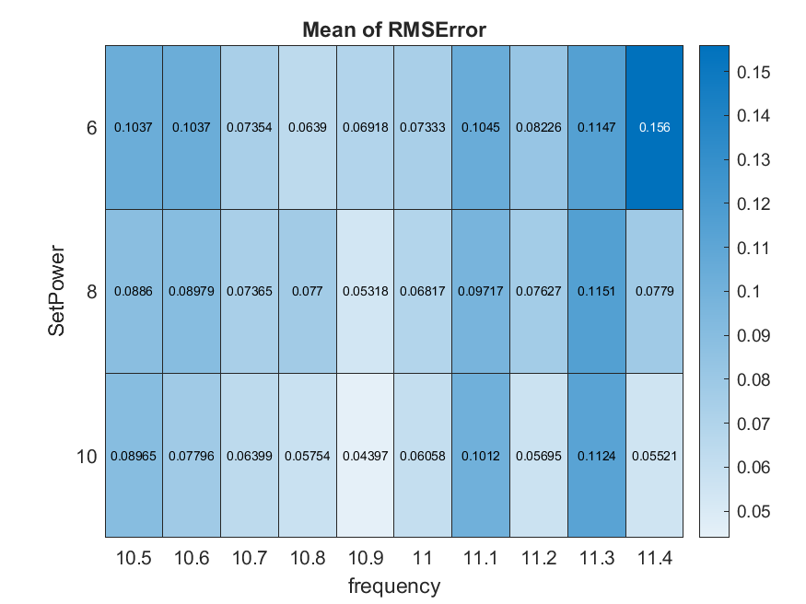
Bias 4

Slide 6
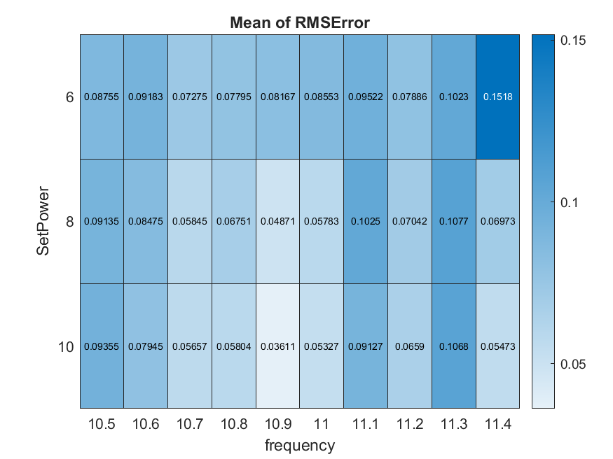
Bias 5

Slide 7
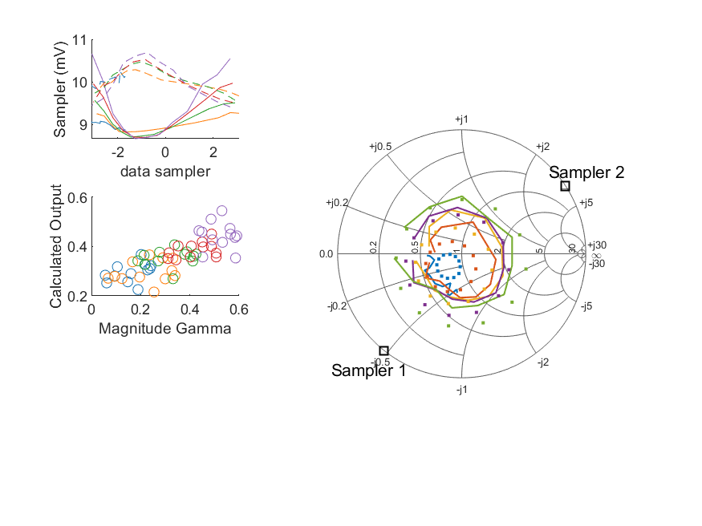
Coupled Line Performance At 10.50 GHz, 16.000000 dBm Output Power .20.999235 V mean sampler bias
Sampler Av
Sampler 1: 227.152
Sampler 2: 227.152
Sampler Offset (rather than -1)
-4.9589907254570731
Goodness Of fit
0.29659659776955111
Sampler 1 Range
0.0019920916400000006
Sampler 2 Range
0.0012764781300000014
DUT output dBm Mean
15.977000064873708
DUT input dBm Mean
16.536866404249761
RMS Error
0.10942953466431313

Slide 8
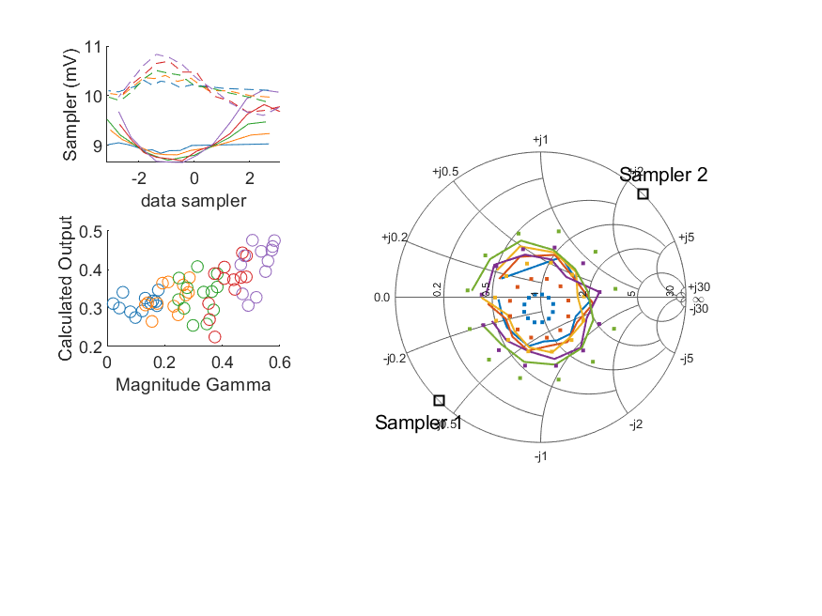
Coupled Line Performance At 10.50 GHz, 16.000000 dBm Output Power .20.999223 V mean sampler bias
Sampler Av
Sampler 1: 231.736
Sampler 2: 231.736
Sampler Offset (rather than -1)
-5.0346653025968191
Goodness Of fit
0.33956594885424674
Sampler 1 Range
0.0014599805300000001
Sampler 2 Range
0.0012302323799999997
DUT output dBm Mean
16.006374434490748
DUT input dBm Mean
16.432863244257156
RMS Error
0.12729368910564726

Slide 9
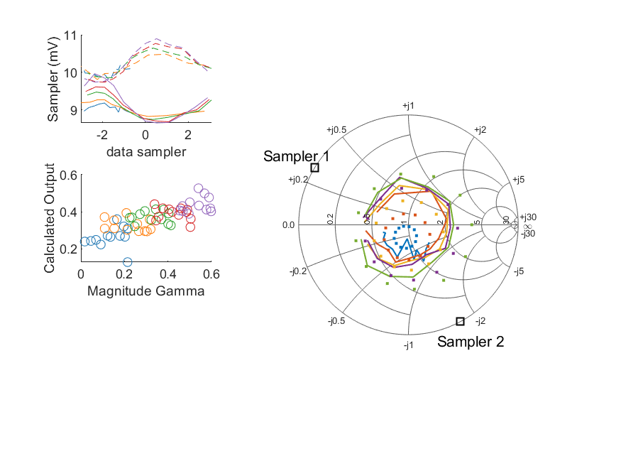
Coupled Line Performance At 10.50 GHz, 16.000000 dBm Output Power .20.999213 V mean sampler bias
Sampler Av
Sampler 1: 300.000
Sampler 2: 300.000
Sampler Offset (rather than -1)
-5.2688039783384495
Goodness Of fit
0.33822836388736321
Sampler 1 Range
0.0013072972599999996
Sampler 2 Range
0.0011553791300000001
DUT output dBm Mean
15.992523832146315
DUT input dBm Mean
16.441726796609444
RMS Error
0.11574543941179434

Slide 10
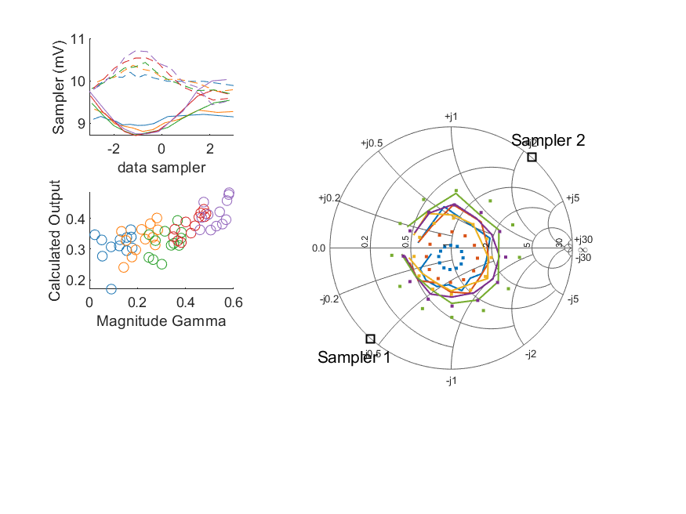
Coupled Line Performance At 10.50 GHz, 16.000000 dBm Output Power .20.999218 V mean sampler bias
Sampler Av
Sampler 1: 224.642
Sampler 2: 224.642
Sampler Offset (rather than -1)
-4.9445807434348268
Goodness Of fit
0.32854738853475263
Sampler 1 Range
0.0013203513900000002
Sampler 2 Range
0.00127373668
DUT output dBm Mean
15.981332574735848
DUT input dBm Mean
16.502310854756875
RMS Error
0.12317588095632792

Slide 11
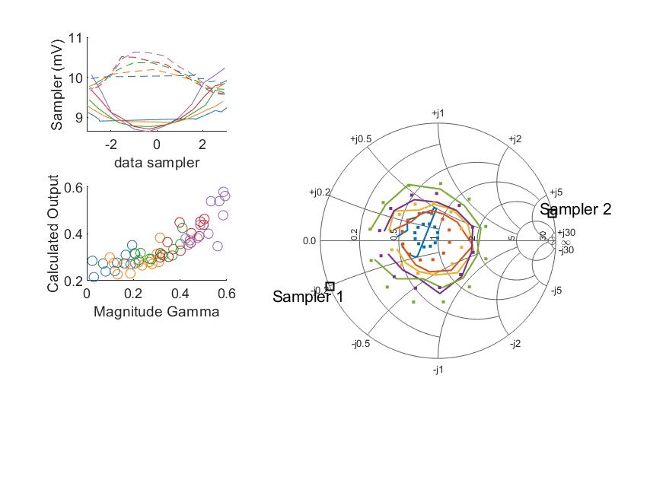
Coupled Line Performance At 10.50 GHz, 16.000000 dBm Output Power .20.999226 V mean sampler bias
Sampler Av
Sampler 1: 300.000
Sampler 2: 300.000
Sampler Offset (rather than -1)
-5.2189376109247938
Goodness Of fit
0.1773125379752378
Sampler 1 Range
0.0015957080399999993
Sampler 2 Range
0.0010599288300000009
DUT output dBm Mean
16.016248211069591
DUT input dBm Mean
16.455437185062358
RMS Error
0.095861222070866781

Slide 12
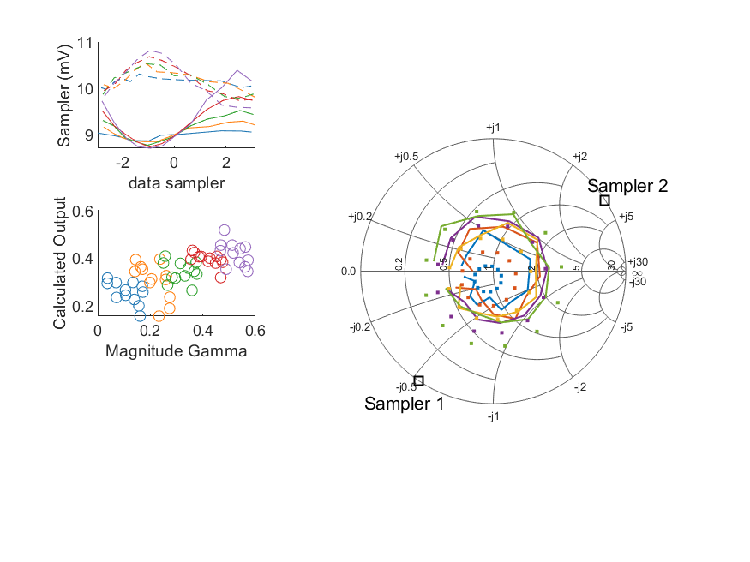
Coupled Line Performance At 10.50 GHz, 16.000000 dBm Output Power .20.999240 V mean sampler bias
Sampler Av
Sampler 1: 259.792
Sampler 2: 259.792
Sampler Offset (rather than -1)
-5.3054583756249718
Goodness Of fit
0.34865776676709137
Sampler 1 Range
0.0016887020999999999
Sampler 2 Range
0.0012441351300000007
DUT output dBm Mean
16.030705172026845
DUT input dBm Mean
16.515711671013904
RMS Error
0.1214659670616814

Slide 13
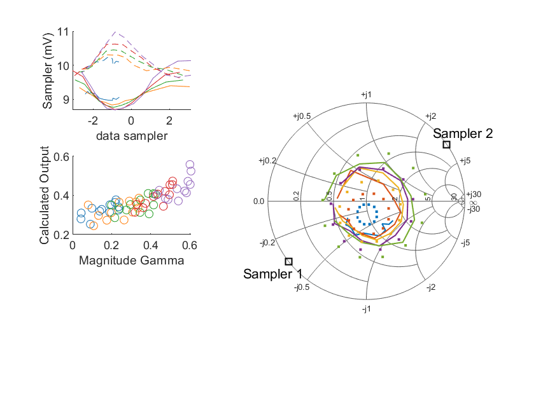
Coupled Line Performance At 10.50 GHz, 16.000000 dBm Output Power .20.999215 V mean sampler bias
Sampler Av
Sampler 1: 173.248
Sampler 2: 173.248
Sampler Offset (rather than -1)
-4.4856679762230174
Goodness Of fit
0.31209814030210009
Sampler 1 Range
0.0014482751200000001
Sampler 2 Range
0.0013505879599999999
DUT output dBm Mean
16.018695872269742
DUT input dBm Mean
16.536042265498892
RMS Error
0.11525599347383104

Slide 14
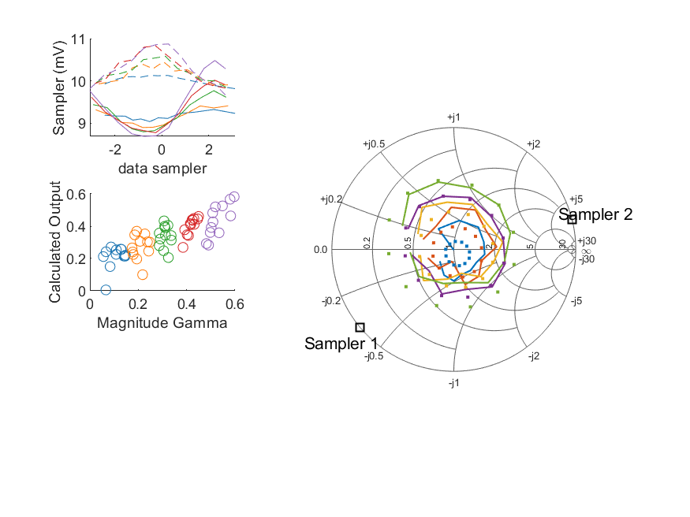
Coupled Line Performance At 10.50 GHz, 16.000000 dBm Output Power .20.999213 V mean sampler bias
Sampler Av
Sampler 1: 245.889
Sampler 2: 245.889
Sampler Offset (rather than -1)
-5.2140440408666526
Goodness Of fit
0.20798499312106328
Sampler 1 Range
0.0017959361399999992
Sampler 2 Range
0.0012089034299999999
DUT output dBm Mean
16.019020540766405
DUT input dBm Mean
16.521409250157678
RMS Error
0.095272537074165706

Slide 15
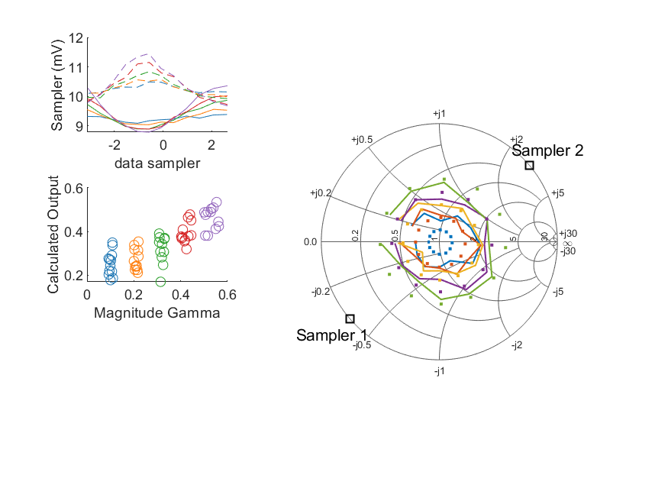
Coupled Line Performance At 10.50 GHz, 16.000000 dBm Output Power .20.999222 V mean sampler bias
Sampler Av
Sampler 1: 300.000
Sampler 2: 300.000
Sampler Offset (rather than -1)
-5.7839040322720932
Goodness Of fit
0.18431262787035477
Sampler 1 Range
0.0015747005700000004
Sampler 2 Range
0.0017707691399999996
DUT output dBm Mean
16.0865275767421
DUT input dBm Mean
16.594647363906169
RMS Error
0.095289155581789603

Slide 16
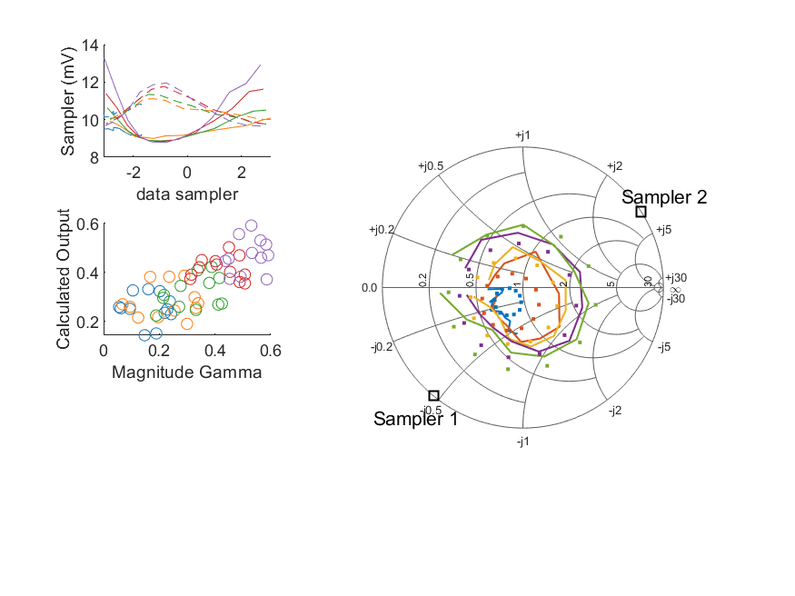
Coupled Line Performance At 10.50 GHz, 18.000000 dBm Output Power .20.999191 V mean sampler bias
Sampler Av
Sampler 1: 111.483
Sampler 2: 111.483
Sampler Offset (rather than -1)
-2.9464667708627239
Goodness Of fit
0.27231313414993086
Sampler 1 Range
0.0045181483200000001
Sampler 2 Range
0.0023147161899999998
DUT output dBm Mean
17.959935464873706
DUT input dBm Mean
18.522906070916424
RMS Error
0.10420286374290495

Slide 17
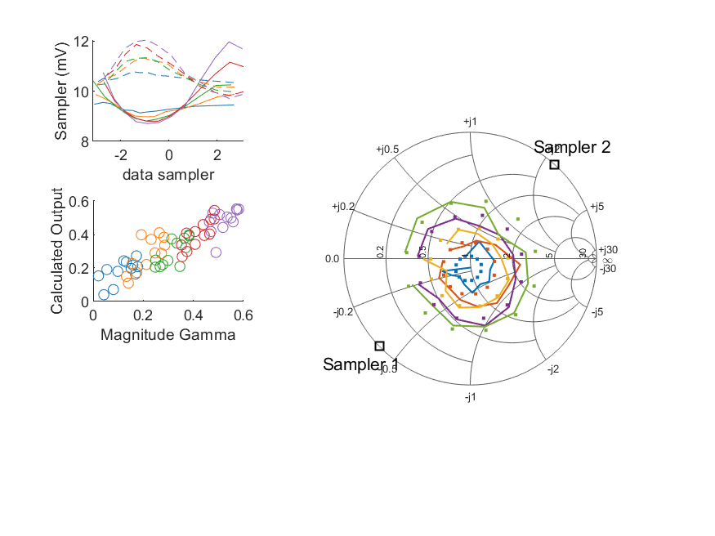
Coupled Line Performance At 10.50 GHz, 18.000000 dBm Output Power .20.999244 V mean sampler bias
Sampler Av
Sampler 1: 173.984
Sampler 2: 173.984
Sampler Offset (rather than -1)
-4.2848902426436402
Goodness Of fit
0.12497552994837399
Sampler 1 Range
0.003257606750000001
Sampler 2 Range
0.0023261220199999998
DUT output dBm Mean
17.983129701157413
DUT input dBm Mean
18.413109244257157
RMS Error
0.074144881357208162

Slide 18
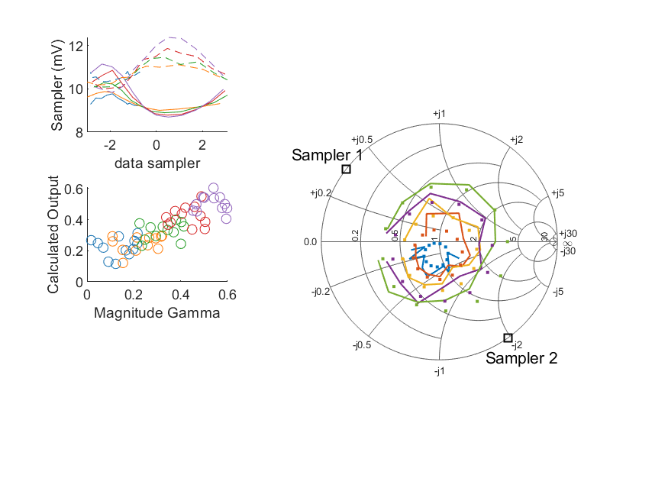
Coupled Line Performance At 10.50 GHz, 18.000000 dBm Output Power .20.999216 V mean sampler bias
Sampler Av
Sampler 1: 264.006
Sampler 2: 264.006
Sampler Offset (rather than -1)
-4.9622094333112434
Goodness Of fit
0.20059024799737038
Sampler 1 Range
0.0024560667400000003
Sampler 2 Range
0.0025483097600000008
DUT output dBm Mean
17.97668296547965
DUT input dBm Mean
18.430521963276114
RMS Error
0.087998138911226598

Slide 19
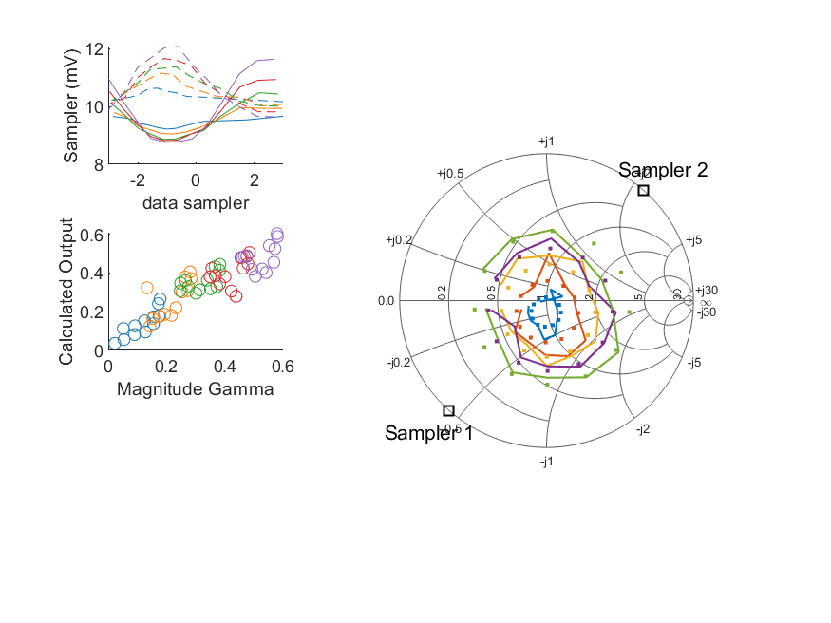
Coupled Line Performance At 10.50 GHz, 18.000000 dBm Output Power .20.999210 V mean sampler bias
Sampler Av
Sampler 1: 191.150
Sampler 2: 191.150
Sampler Offset (rather than -1)
-4.6594483867952912
Goodness Of fit
0.13517745635076683
Sampler 1 Range
0.0028734214899999999
Sampler 2 Range
0.0024285747199999999
DUT output dBm Mean
17.963245474735846
DUT input dBm Mean
18.48621218809021
RMS Error
0.067329136205075468

Slide 20
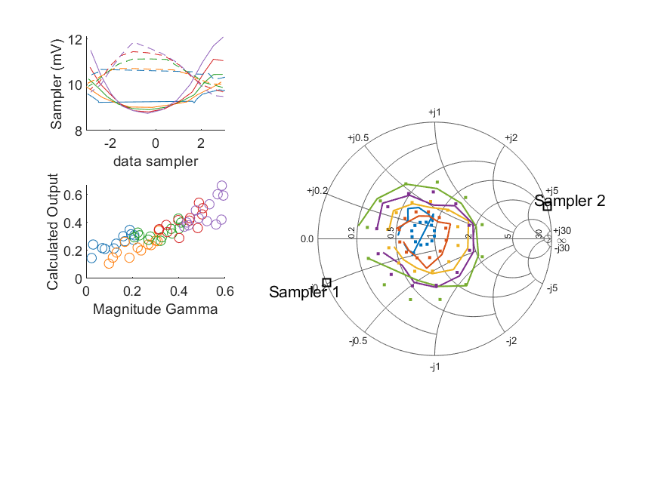
Coupled Line Performance At 10.50 GHz, 18.000000 dBm Output Power .20.999206 V mean sampler bias
Sampler Av
Sampler 1: 223.024
Sampler 2: 223.024
Sampler Offset (rather than -1)
-4.319327717584474
Goodness Of fit
0.1556213755129322
Sampler 1 Range
0.0033468574999999997
Sampler 2 Range
0.0023843007199999995
DUT output dBm Mean
17.993140827736262
DUT input dBm Mean
18.435685851729023
RMS Error
0.080463422889506461

Slide 21
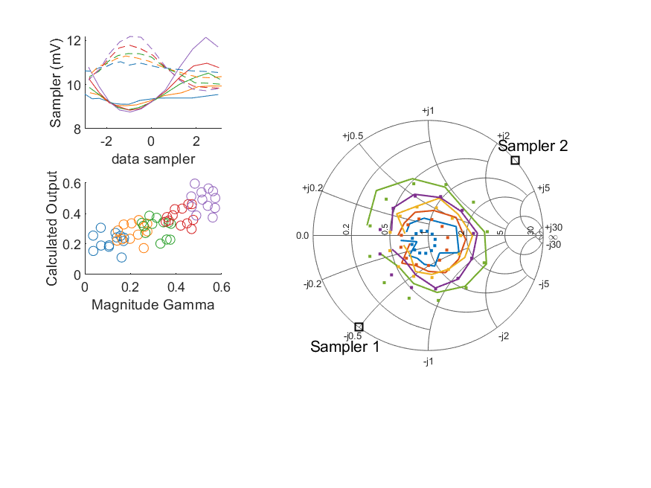
Coupled Line Performance At 10.50 GHz, 18.000000 dBm Output Power .20.999220 V mean sampler bias
Sampler Av
Sampler 1: 205.717
Sampler 2: 205.717
Sampler Offset (rather than -1)
-4.669151278955213
Goodness Of fit
0.20879473454168285
Sampler 1 Range
0.0033778816000000003
Sampler 2 Range
0.0024521222700000008
DUT output dBm Mean
18.008551772026845
DUT input dBm Mean
18.494773337680574
RMS Error
0.095018112859653031

Slide 22
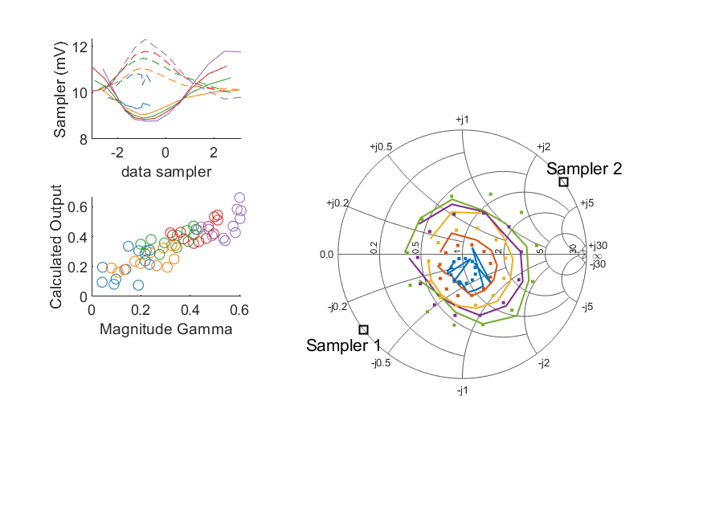
Coupled Line Performance At 10.50 GHz, 18.000000 dBm Output Power .20.999214 V mean sampler bias
Sampler Av
Sampler 1: 171.389
Sampler 2: 171.389
Sampler Offset (rather than -1)
-4.6732911693991674
Goodness Of fit
0.18419870177630329
Sampler 1 Range
0.0030164019599999998
Sampler 2 Range
0.00257565274
DUT output dBm Mean
17.979728272269742
DUT input dBm Mean
18.499726432165559
RMS Error
0.081678705150544983

Slide 23
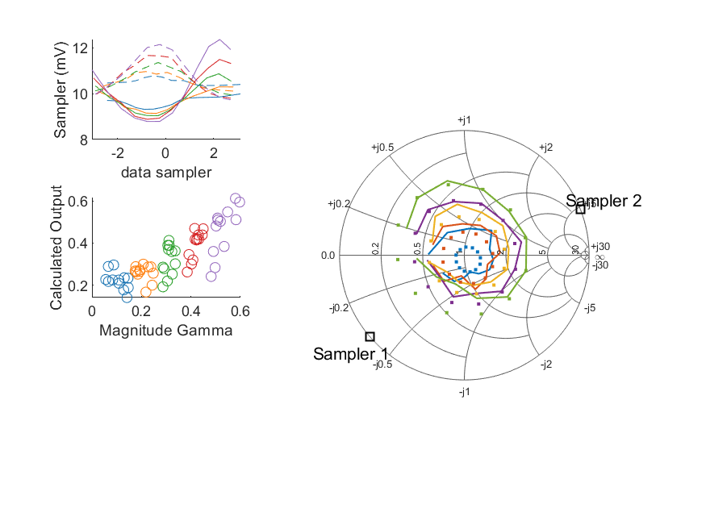
Coupled Line Performance At 10.50 GHz, 18.000000 dBm Output Power .20.999207 V mean sampler bias
Sampler Av
Sampler 1: 166.322
Sampler 2: 166.322
Sampler Offset (rather than -1)
-3.8178500446722303
Goodness Of fit
0.17583265915014337
Sampler 1 Range
0.0035670805800000014
Sampler 2 Range
0.0024050320300000004
DUT output dBm Mean
17.990927457433074
DUT input dBm Mean
18.496039083491009
RMS Error
0.092634938340289297

Slide 24
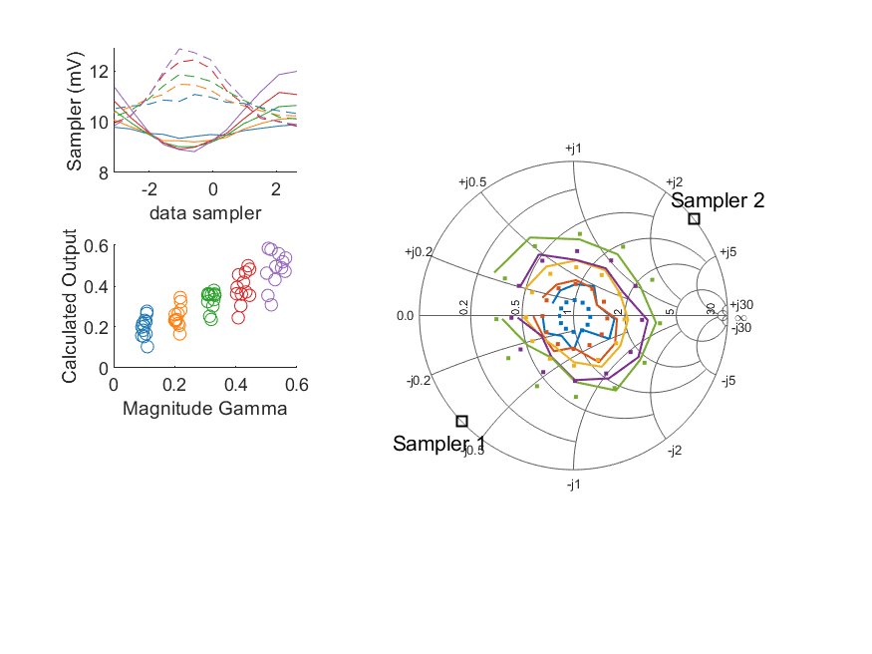
Coupled Line Performance At 10.50 GHz, 18.000000 dBm Output Power .20.999212 V mean sampler bias
Sampler Av
Sampler 1: 189.245
Sampler 2: 189.245
Sampler Offset (rather than -1)
-3.7656455028588147
Goodness Of fit
0.15724030712982112
Sampler 1 Range
0.0031735792000000002
Sampler 2 Range
0.0030626643799999999
DUT output dBm Mean
17.980571610075433
DUT input dBm Mean
18.489044197239501
RMS Error
0.078931521086189449

Slide 25
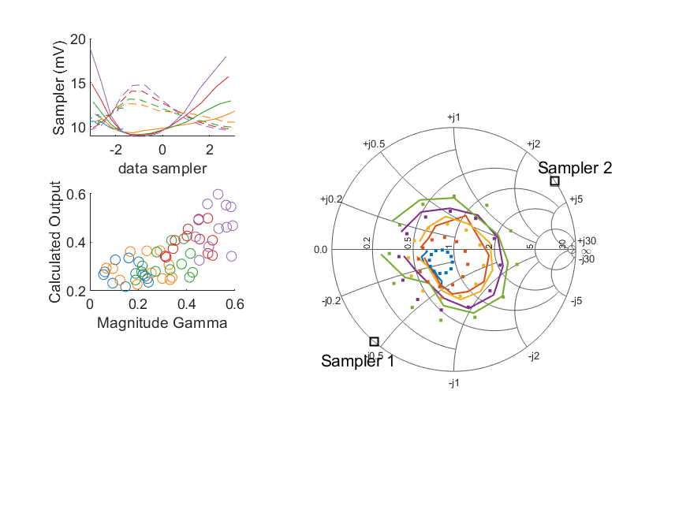
Coupled Line Performance At 10.50 GHz, 20.000000 dBm Output Power .20.999217 V mean sampler bias
Sampler Av
Sampler 1: 51.400
Sampler 2: 51.400
Sampler Offset (rather than -1)
-1.4734617081508268
Goodness Of fit
0.27851965693935066
Sampler 1 Range
0.0099566262000000023
Sampler 2 Range
0.0051476555499999996
DUT output dBm Mean
19.95554321154037
DUT input dBm Mean
20.523195237583092
RMS Error
0.10681914131501866

Slide 26
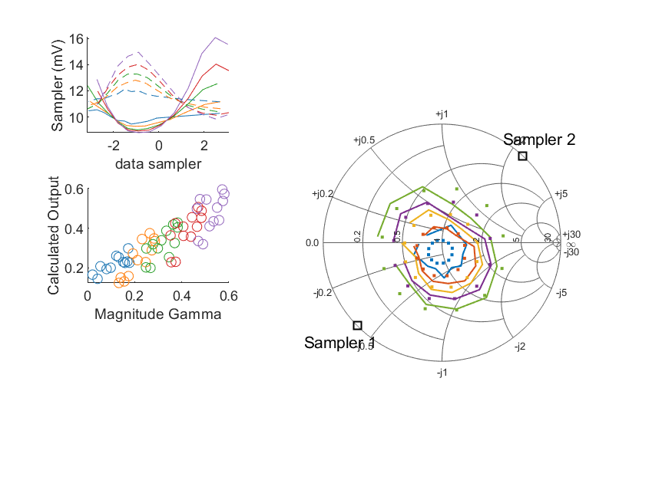
Coupled Line Performance At 10.50 GHz, 20.000000 dBm Output Power .20.999219 V mean sampler bias
Sampler Av
Sampler 1: 74.385
Sampler 2: 74.385
Sampler Offset (rather than -1)
-2.0515521839547595
Goodness Of fit
0.14340225745762611
Sampler 1 Range
0.0072822694399999992
Sampler 2 Range
0.0050997337400000009
DUT output dBm Mean
19.974841077824081
DUT input dBm Mean
20.410741244257153
RMS Error
0.077873377670350519

Slide 27
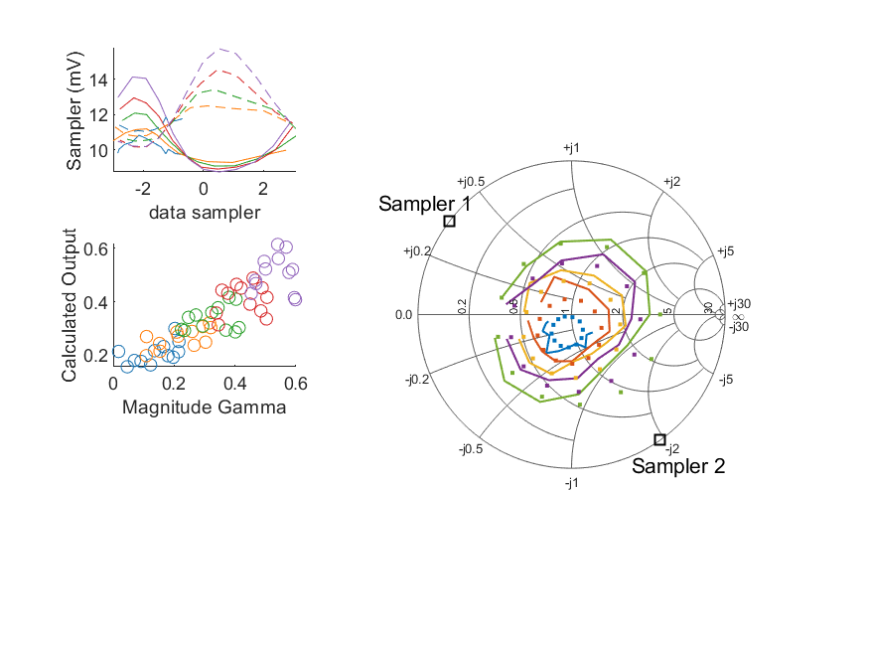
Coupled Line Performance At 10.50 GHz, 20.000000 dBm Output Power .20.999200 V mean sampler bias
Sampler Av
Sampler 1: 113.289
Sampler 2: 113.289
Sampler Offset (rather than -1)
-2.2415478311787611
Goodness Of fit
0.18962766054386526
Sampler 1 Range
0.0053848223500000004
Sampler 2 Range
0.0055721395
DUT output dBm Mean
19.958332762146316
DUT input dBm Mean
20.41704446327611
RMS Error
0.078977229226621565

Slide 28
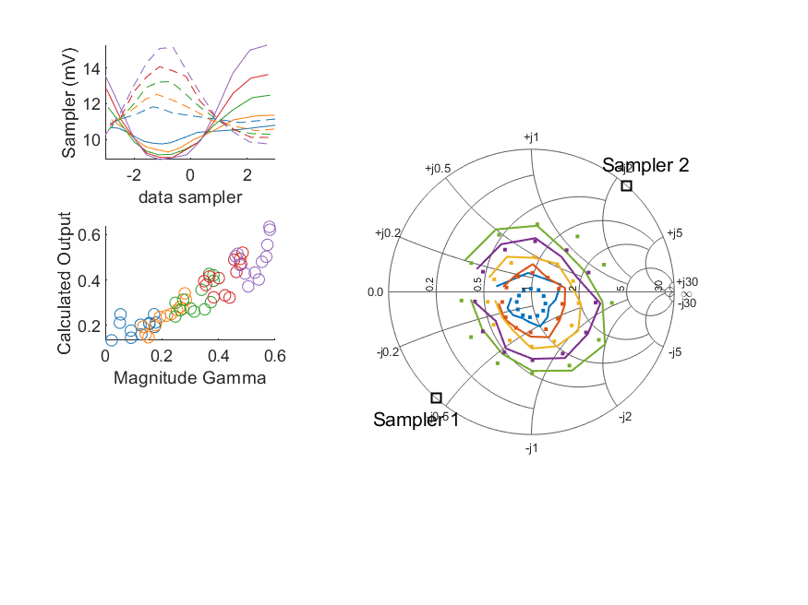
Coupled Line Performance At 10.50 GHz, 20.000000 dBm Output Power .20.999221 V mean sampler bias
Sampler Av
Sampler 1: 82.765
Sampler 2: 82.765
Sampler Offset (rather than -1)
-2.1859852335018912
Goodness Of fit
0.10808662158863716
Sampler 1 Range
0.0064317378999999997
Sampler 2 Range
0.0054199977599999997
DUT output dBm Mean
19.952081954735846
DUT input dBm Mean
20.47927202142354
RMS Error
0.064331795410761283

Slide 29
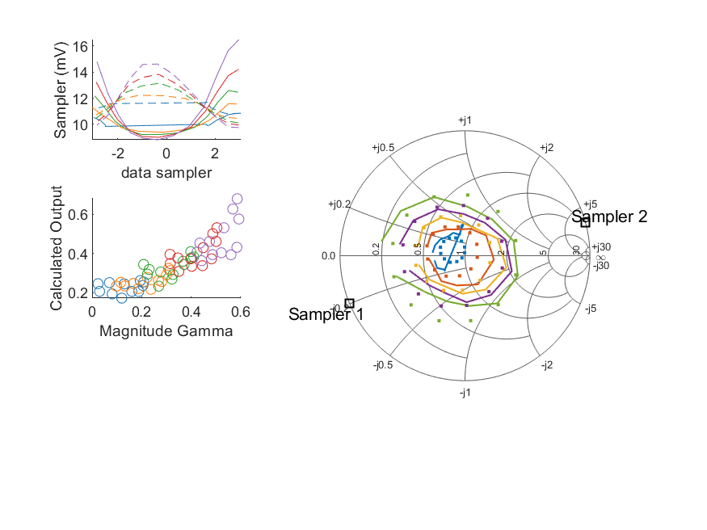
Coupled Line Performance At 10.50 GHz, 20.000000 dBm Output Power .20.999235 V mean sampler bias
Sampler Av
Sampler 1: 85.692
Sampler 2: 85.692
Sampler Offset (rather than -1)
-1.7557627061508041
Goodness Of fit
0.1543072679916638
Sampler 1 Range
0.0076628337100000006
Sampler 2 Range
0.0048594526300000003
DUT output dBm Mean
19.977352177736257
DUT input dBm Mean
20.424458351729022
RMS Error
0.080797241194956515

Slide 30
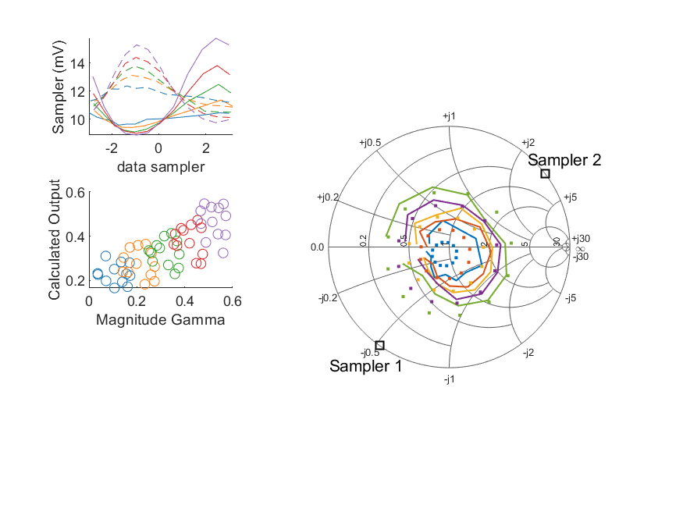
Coupled Line Performance At 10.50 GHz, 20.000000 dBm Output Power .20.999197 V mean sampler bias
Sampler Av
Sampler 1: 76.602
Sampler 2: 76.602
Sampler Offset (rather than -1)
-1.8370416636954474
Goodness Of fit
0.258716271047843
Sampler 1 Range
0.0068900518300000005
Sampler 2 Range
0.0055399417900000008
DUT output dBm Mean
19.994615322026846
DUT input dBm Mean
20.484890337680568
RMS Error
0.10424800762302483

Slide 31
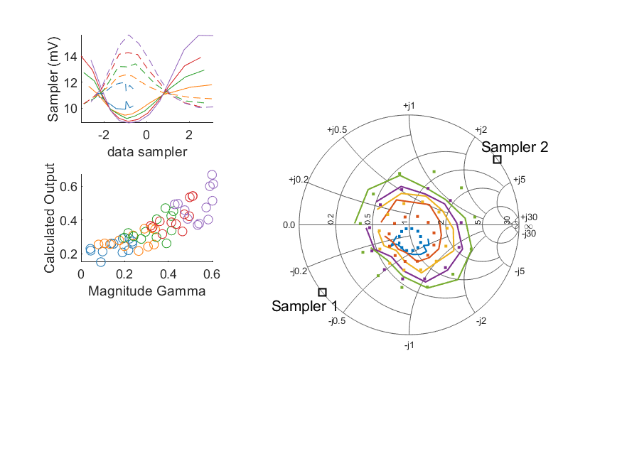
Coupled Line Performance At 10.50 GHz, 20.000000 dBm Output Power .20.999225 V mean sampler bias
Sampler Av
Sampler 1: 67.067
Sampler 2: 67.067
Sampler Offset (rather than -1)
-1.9785290981218748
Goodness Of fit
0.20276094686188101
Sampler 1 Range
0.0067455398900000008
Sampler 2 Range
0.0056047476999999991
DUT output dBm Mean
19.96827742226974
DUT input dBm Mean
20.490608598832225
RMS Error
0.08682518854479665

Slide 32
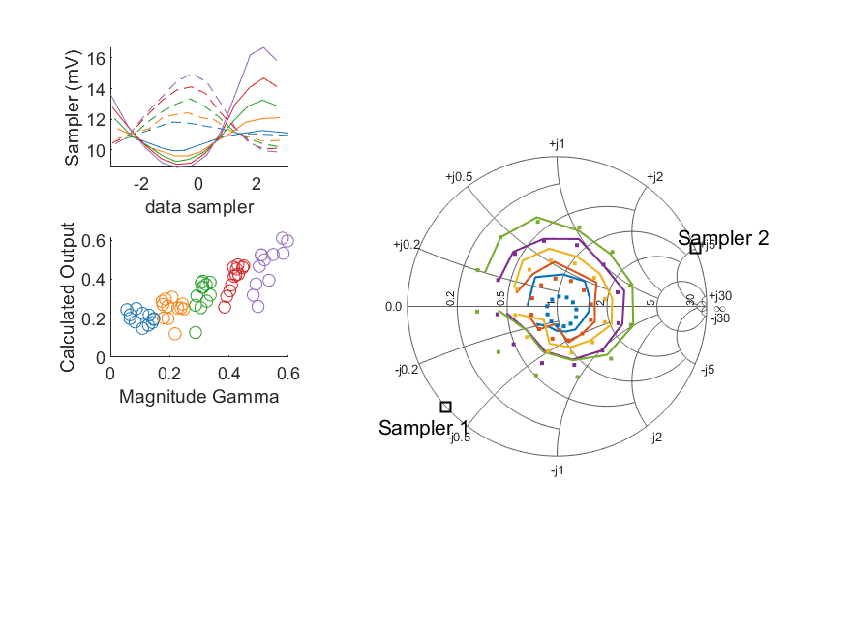
Coupled Line Performance At 10.50 GHz, 20.000000 dBm Output Power .20.999230 V mean sampler bias
Sampler Av
Sampler 1: 73.762
Sampler 2: 73.762
Sampler Offset (rather than -1)
-1.8437619485973902
Goodness Of fit
0.14266040965551441
Sampler 1 Range
0.0078562109700000011
Sampler 2 Range
0.0051166942600000005
DUT output dBm Mean
19.988452007433072
DUT input dBm Mean
20.497250916824342
RMS Error
0.082538206587033952

Slide 33
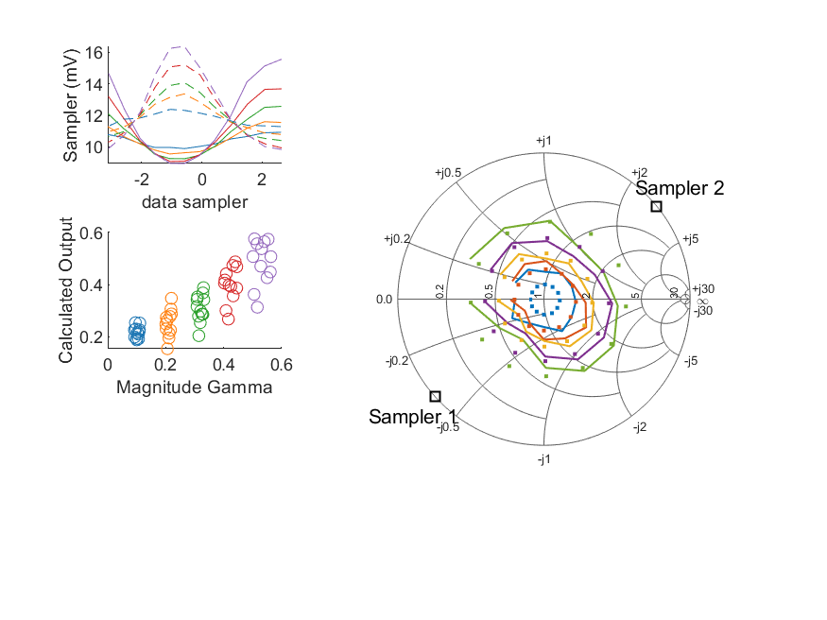
Coupled Line Performance At 10.50 GHz, 20.000000 dBm Output Power .20.999207 V mean sampler bias
Sampler Av
Sampler 1: 88.623
Sampler 2: 88.623
Sampler Offset (rather than -1)
-1.9253469243467527
Goodness Of fit
0.15523573327157825
Sampler 1 Range
0.00660045821
Sampler 2 Range
0.006531292670000001
DUT output dBm Mean
19.970183193408769
DUT input dBm Mean
20.479517863906167
RMS Error
0.081113168588685655

Slide 35
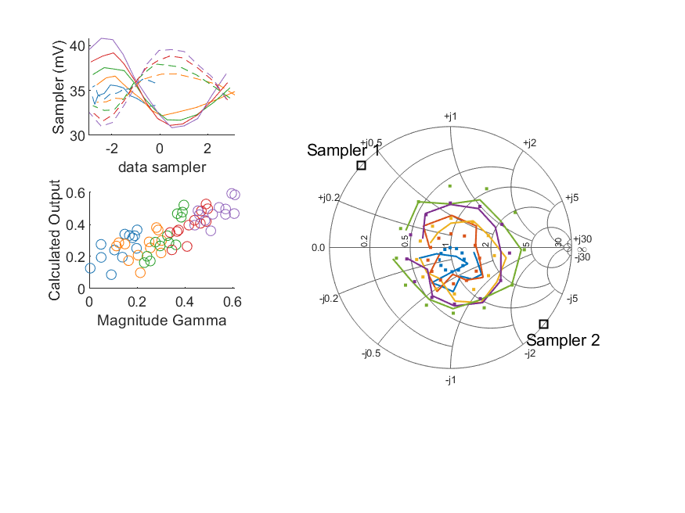
Coupled Line Performance At 10.60 GHz, 12.000000 dBm Output Power .21.248904 V mean sampler bias
Sampler Av
Sampler 1: 88.632
Sampler 2: 88.632
Sampler Offset (rather than -1)
-6.7780663365917651
Goodness Of fit
0.19388687030887747
Sampler 1 Range
0.0099674870000000006
Sampler 2 Range
0.0085527537999999965
DUT output dBm Mean
11.976901648866415
DUT input dBm Mean
12.353844049913482
RMS Error
0.098990634570756394

Slide 36
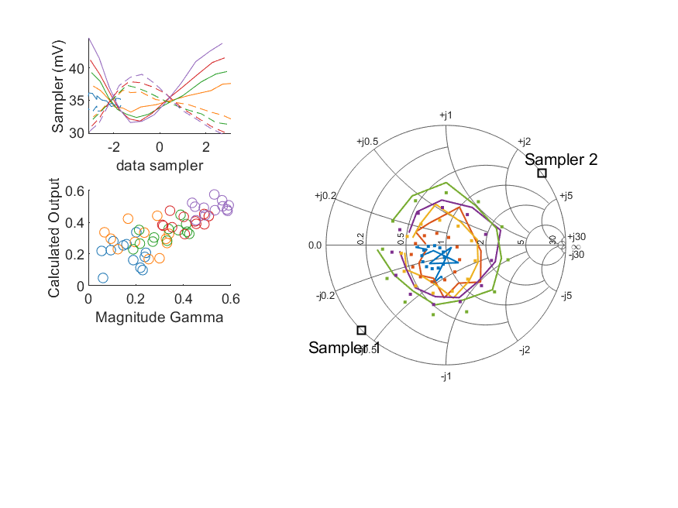
Coupled Line Performance At 10.60 GHz, 12.000000 dBm Output Power .21.248921 V mean sampler bias
Sampler Av
Sampler 1: 70.790
Sampler 2: 70.790
Sampler Offset (rather than -1)
-5.7628589825621983
Goodness Of fit
0.21427494227440969
Sampler 1 Range
0.013187516100000005
Sampler 2 Range
0.0093026511999999978
DUT output dBm Mean
11.958798698207039
DUT input dBm Mean
12.513336070916427
RMS Error
0.10473423717739151

Slide 37
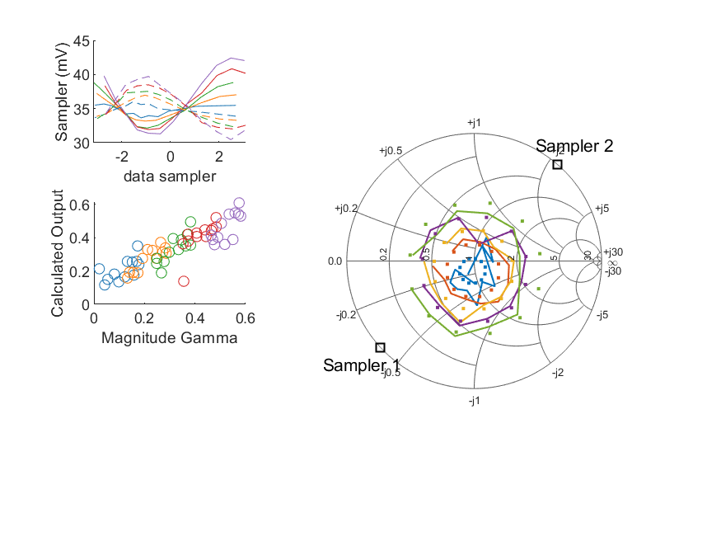
Coupled Line Performance At 10.60 GHz, 12.000000 dBm Output Power .21.248916 V mean sampler bias
Sampler Av
Sampler 1: 70.540
Sampler 2: 70.540
Sampler Offset (rather than -1)
-5.9597706130851771
Goodness Of fit
0.14147800926054194
Sampler 1 Range
0.011118621100000003
Sampler 2 Range
0.0092697392999999996
DUT output dBm Mean
11.997153467824084
DUT input dBm Mean
12.418875077590487
RMS Error
0.083980621049979345

Slide 38
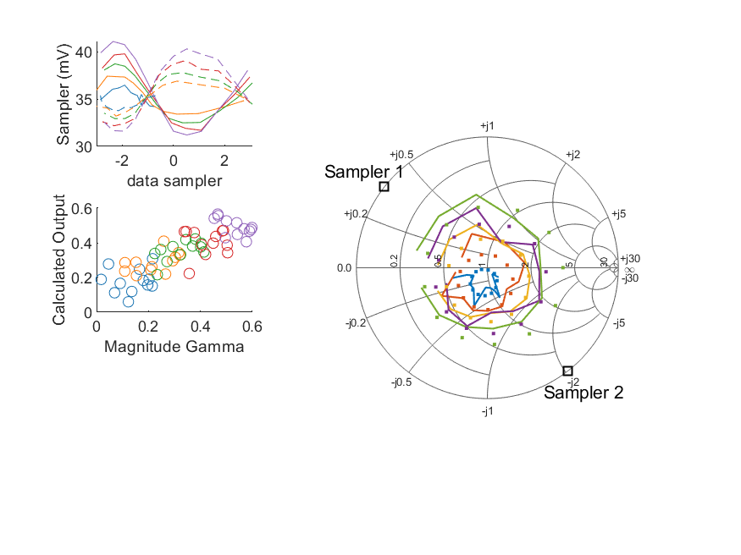
Coupled Line Performance At 10.60 GHz, 12.000000 dBm Output Power .21.248923 V mean sampler bias
Sampler Av
Sampler 1: 84.791
Sampler 2: 84.791
Sampler Offset (rather than -1)
-6.0555961338229176
Goodness Of fit
0.24427691014149377
Sampler 1 Range
0.0098907387999999964
Sampler 2 Range
0.0087076105000000042
DUT output dBm Mean
11.975856498812982
DUT input dBm Mean
12.420220629942779
RMS Error
0.089791085857427969

Slide 39
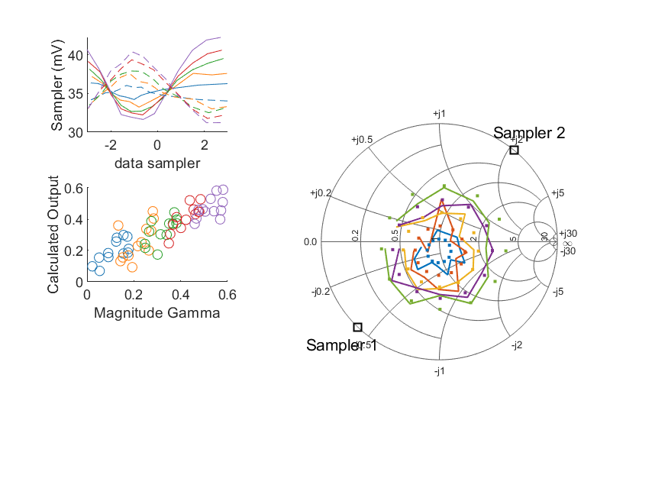
Coupled Line Performance At 10.60 GHz, 12.000000 dBm Output Power .21.248915 V mean sampler bias
Sampler Av
Sampler 1: 76.099
Sampler 2: 76.099
Sampler Offset (rather than -1)
-6.3493440587159684
Goodness Of fit
0.15860812686628695
Sampler 1 Range
0.0106039915
Sampler 2 Range
0.0091782476999999994
DUT output dBm Mean
11.969014041402515
DUT input dBm Mean
12.486833688090208
RMS Error
0.082257766168278998

Slide 40
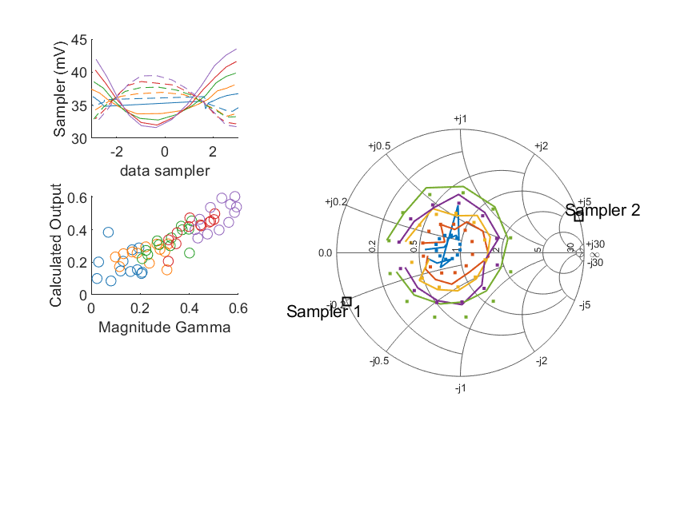
Coupled Line Performance At 10.60 GHz, 12.000000 dBm Output Power .21.248912 V mean sampler bias
Sampler Av
Sampler 1: 81.940
Sampler 2: 81.940
Sampler Offset (rather than -1)
-6.1989665258400226
Goodness Of fit
0.12969249242335995
Sampler 1 Range
0.011907188299999996
Sampler 2 Range
0.0077487691999999983
DUT output dBm Mean
11.992998894402925
DUT input dBm Mean
12.428040351729027
RMS Error
0.079576639426186715

Slide 41
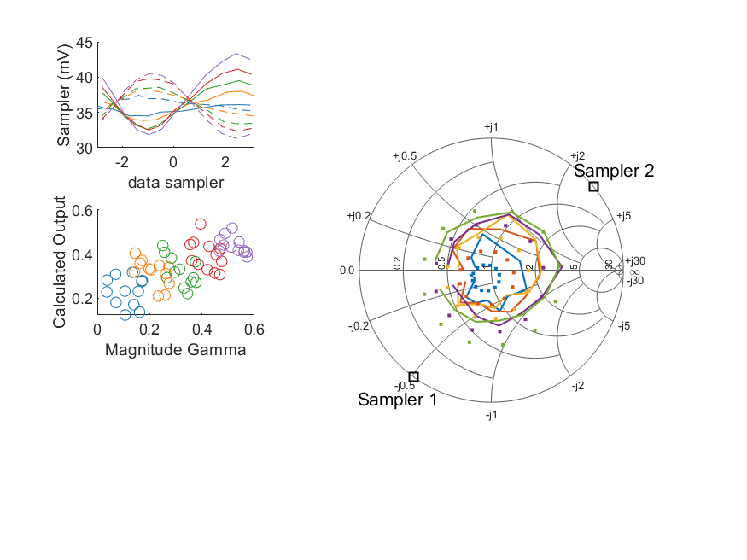
Coupled Line Performance At 10.60 GHz, 12.000000 dBm Output Power .21.248900 V mean sampler bias
Sampler Av
Sampler 1: 70.430
Sampler 2: 70.430
Sampler Offset (rather than -1)
-5.5476027475537846
Goodness Of fit
0.34649790862766333
Sampler 1 Range
0.011482643899999999
Sampler 2 Range
0.0091563532000000017
DUT output dBm Mean
12.017527838693509
DUT input dBm Mean
12.502356837680573
RMS Error
0.11797616125614437

Slide 42
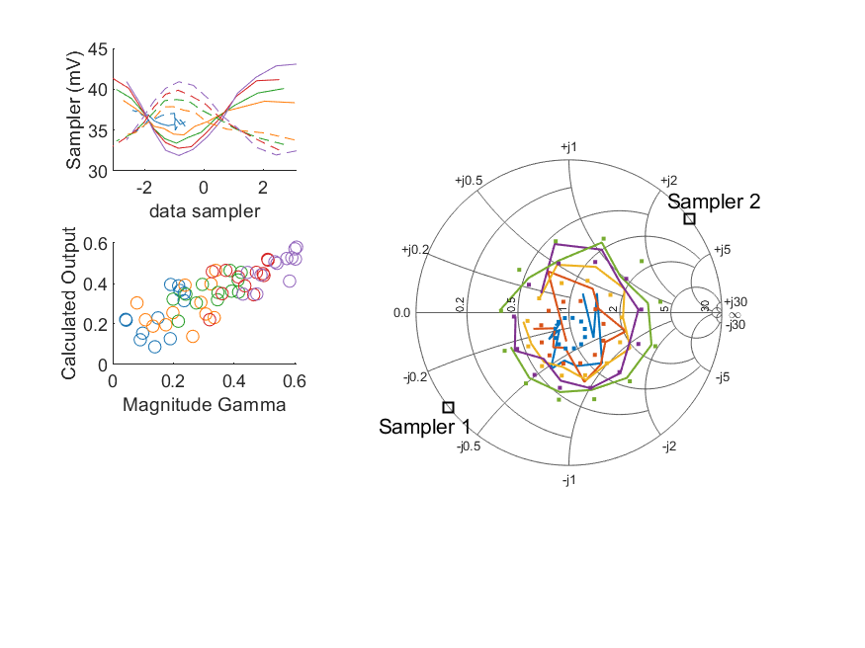
Coupled Line Performance At 10.60 GHz, 12.000000 dBm Output Power .21.248903 V mean sampler bias
Sampler Av
Sampler 1: 87.761
Sampler 2: 87.761
Sampler Offset (rather than -1)
-7.8038417473022959
Goodness Of fit
0.21235047376111407
Sampler 1 Range
0.0111880559
Sampler 2 Range
0.008962076200000002
DUT output dBm Mean
11.994101038936408
DUT input dBm Mean
12.505068598832226
RMS Error
0.10124155206624591

Slide 43
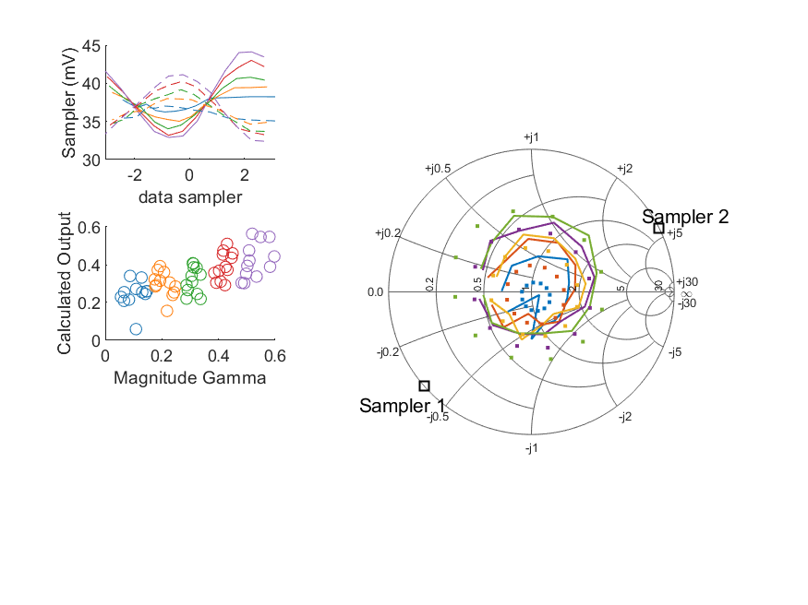
Coupled Line Performance At 10.60 GHz, 12.000000 dBm Output Power .21.248892 V mean sampler bias
Sampler Av
Sampler 1: 56.330
Sampler 2: 56.330
Sampler Offset (rather than -1)
-4.5648580201544924
Goodness Of fit
0.31228318025263757
Sampler 1 Range
0.011225161599999998
Sampler 2 Range
0.0087220051000000062
DUT output dBm Mean
12.004443240766403
DUT input dBm Mean
12.503734083491009
RMS Error
0.11478815886610402

Slide 44
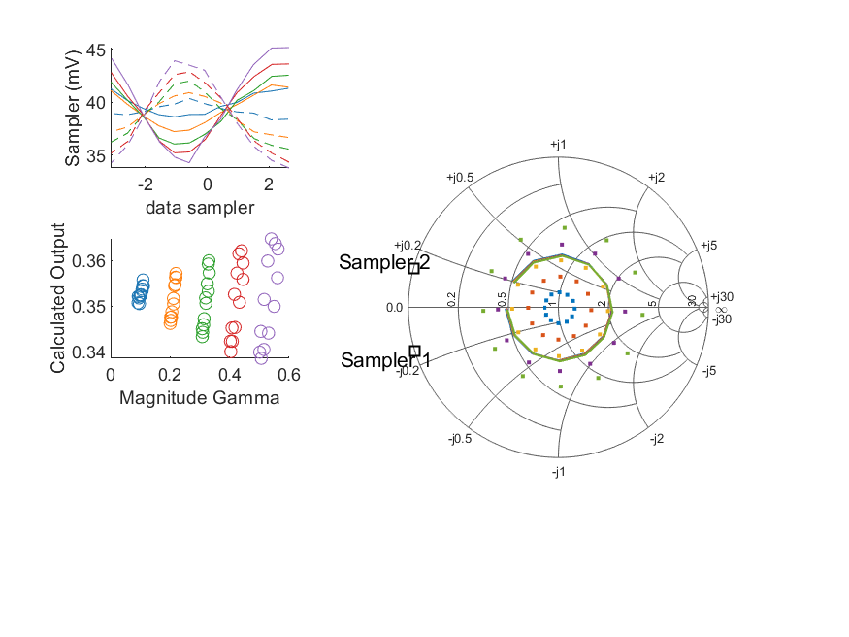
Coupled Line Performance At 10.60 GHz, 12.000000 dBm Output Power .21.248923 V mean sampler bias
Sampler Av
Sampler 1: 0.000
Sampler 2: 0.000
Sampler Offset (rather than -1)
0.053198373409963841
Goodness Of fit
0.58132923177977436
Sampler 1 Range
0.010881632800000006
Sampler 2 Range
0.010130398300000003
DUT output dBm Mean
11.992064560075432
DUT input dBm Mean
12.492317363906171
RMS Error
0.1560300060537306

Slide 45
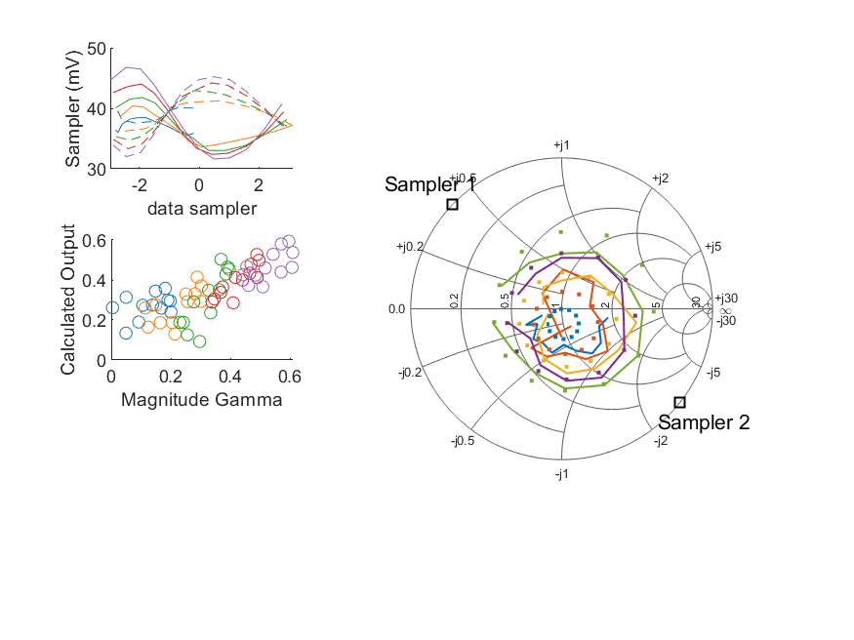
Coupled Line Performance At 10.60 GHz, 14.000000 dBm Output Power .21.248926 V mean sampler bias
Sampler Av
Sampler 1: 61.948
Sampler 2: 61.948
Sampler Offset (rather than -1)
-5.0770096152897057
Goodness Of fit
0.2030191266228086
Sampler 1 Range
0.015155860699999996
Sampler 2 Range
0.0131941582
DUT output dBm Mean
13.931799315533082
DUT input dBm Mean
14.31060671658015
RMS Error
0.10845415718616425

Slide 46
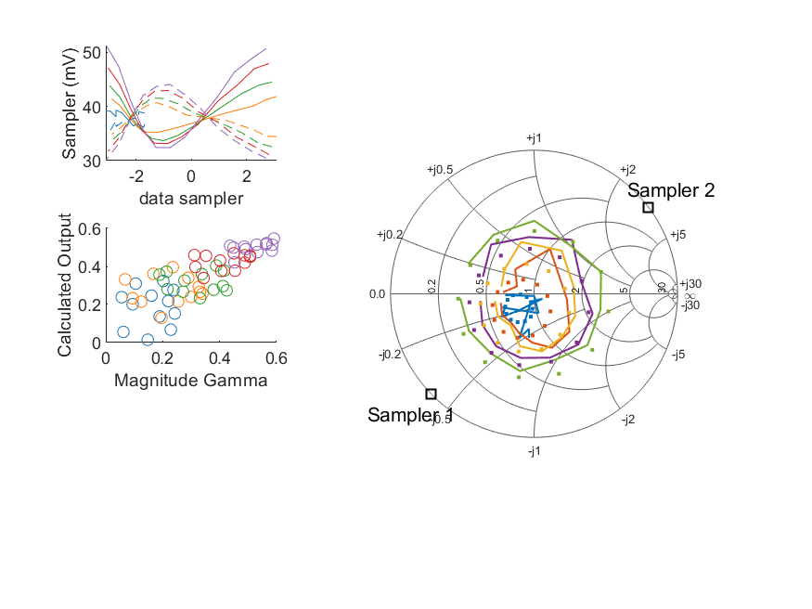
Coupled Line Performance At 10.60 GHz, 14.000000 dBm Output Power .21.248917 V mean sampler bias
Sampler Av
Sampler 1: 60.384
Sampler 2: 60.384
Sampler Offset (rather than -1)
-5.3023523153256003
Goodness Of fit
0.18771950438488202
Sampler 1 Range
0.0188729724
Sampler 2 Range
0.0139264305
DUT output dBm Mean
13.916250781540374
DUT input dBm Mean
14.471695737583095
RMS Error
0.10378629322247801

Slide 47
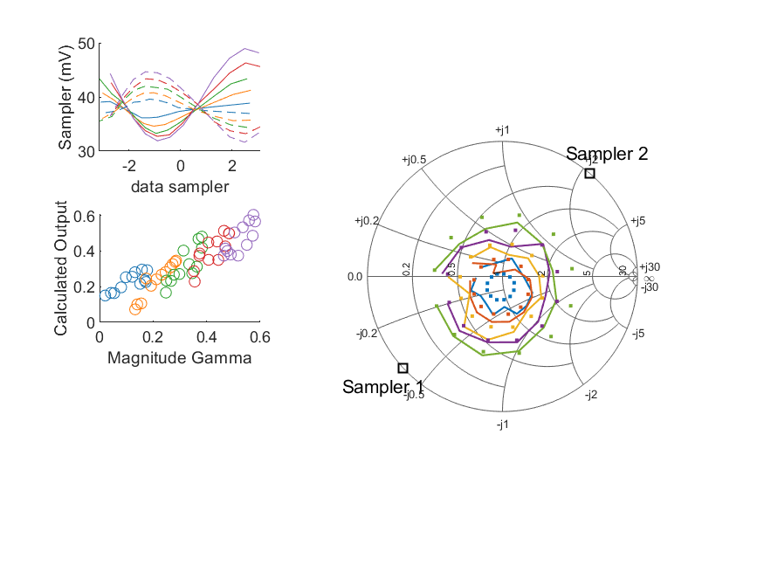
Coupled Line Performance At 10.60 GHz, 14.000000 dBm Output Power .21.248914 V mean sampler bias
Sampler Av
Sampler 1: 54.327
Sampler 2: 54.327
Sampler Offset (rather than -1)
-4.9666147845351007
Goodness Of fit
0.13280176571225455
Sampler 1 Range
0.017037334299999998
Sampler 2 Range
0.013024919400000001
DUT output dBm Mean
13.948978601157418
DUT input dBm Mean
14.371430244257152
RMS Error
0.078300838120213295

Slide 48
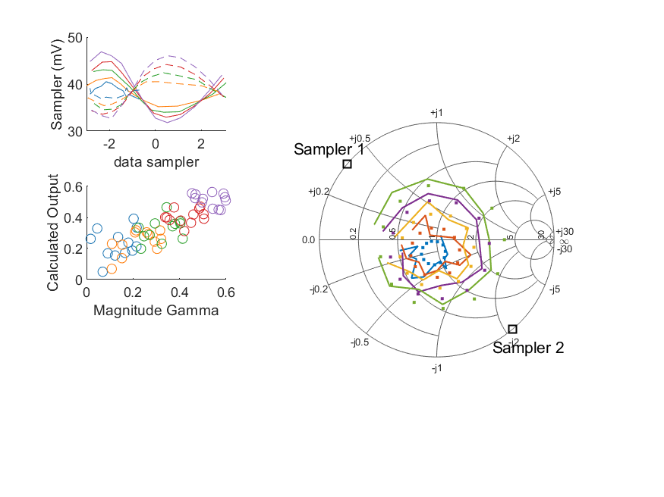
Coupled Line Performance At 10.60 GHz, 14.000000 dBm Output Power .21.248913 V mean sampler bias
Sampler Av
Sampler 1: 74.498
Sampler 2: 74.498
Sampler Offset (rather than -1)
-5.8265726638043649
Goodness Of fit
0.19862295195821583
Sampler 1 Range
0.015074823399999999
Sampler 2 Range
0.013384951000000006
DUT output dBm Mean
13.935490482146317
DUT input dBm Mean
14.380258629942778
RMS Error
0.091365570482828798

Slide 49
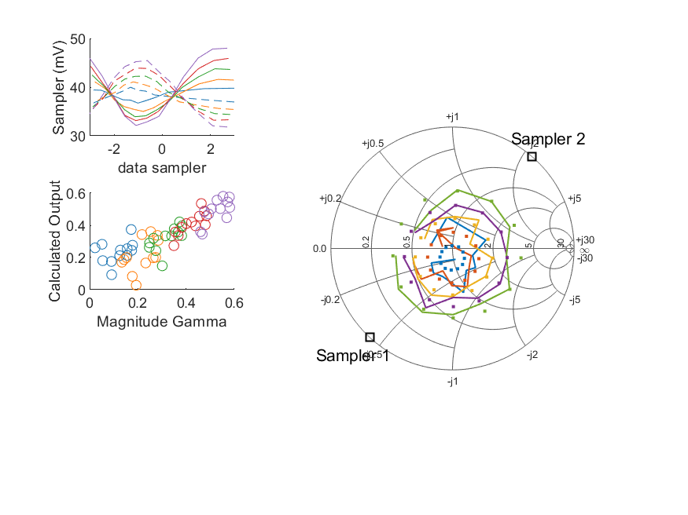
Coupled Line Performance At 10.60 GHz, 14.000000 dBm Output Power .21.248911 V mean sampler bias
Sampler Av
Sampler 1: 65.880
Sampler 2: 65.880
Sampler Offset (rather than -1)
-5.8585037500897341
Goodness Of fit
0.11888283821436368
Sampler 1 Range
0.015875308500000004
Sampler 2 Range
0.0136401939
DUT output dBm Mean
13.92341220806918
DUT input dBm Mean
14.440601854756876
RMS Error
0.090601224982765044

Slide 50

Coupled Line Performance At 10.60 GHz, 14.000000 dBm Output Power .21.248925 V mean sampler bias
Sampler Av
Sampler 1: 63.361
Sampler 2: 63.361
Sampler Offset (rather than -1)
-5.0206401504858267
Goodness Of fit
0.083161398738226935
Sampler 1 Range
0.017542516399999999
Sampler 2 Range
0.012923306100000004
DUT output dBm Mean
13.950980761069593
DUT input dBm Mean
14.385472351729023
RMS Error
0.069094613082610806

Slide 51
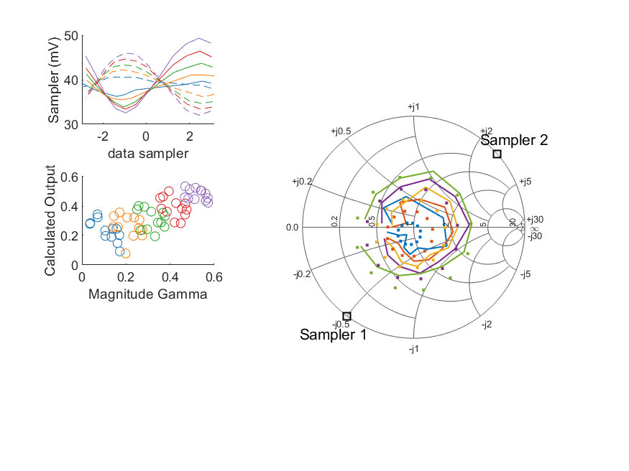
Coupled Line Performance At 10.60 GHz, 14.000000 dBm Output Power .21.248923 V mean sampler bias
Sampler Av
Sampler 1: 57.313
Sampler 2: 57.313
Sampler Offset (rather than -1)
-4.804384595964013
Goodness Of fit
0.25012107504452824
Sampler 1 Range
0.016800202899999998
Sampler 2 Range
0.013965133599999999
DUT output dBm Mean
13.971304322026844
DUT input dBm Mean
14.456050671013907
RMS Error
0.11010161577982559

Slide 52
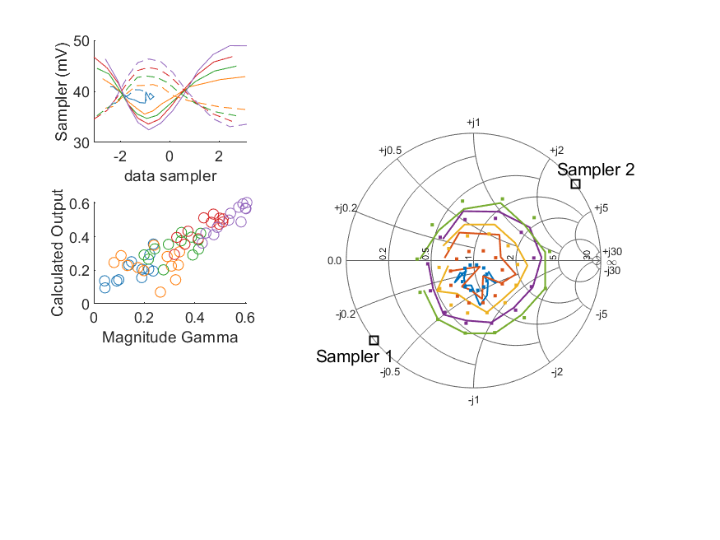
Coupled Line Performance At 10.60 GHz, 14.000000 dBm Output Power .21.248883 V mean sampler bias
Sampler Av
Sampler 1: 68.545
Sampler 2: 68.545
Sampler Offset (rather than -1)
-6.5255995636224506
Goodness Of fit
0.10219185914688647
Sampler 1 Range
0.016489588700000002
Sampler 2 Range
0.013261095100000002
DUT output dBm Mean
13.944304438936406
DUT input dBm Mean
14.454856765498896
RMS Error
0.0776842403187364

Slide 53
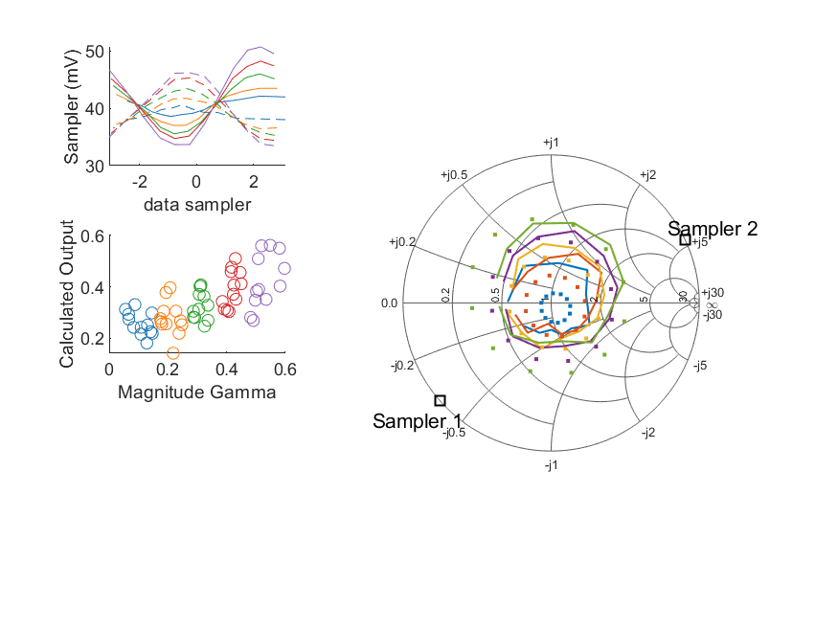
Coupled Line Performance At 10.60 GHz, 14.000000 dBm Output Power .21.248880 V mean sampler bias
Sampler Av
Sampler 1: 38.404
Sampler 2: 38.404
Sampler Offset (rather than -1)
-3.3146097005892838
Goodness Of fit
0.30082998930090349
Sampler 1 Range
0.0170844629
Sampler 2 Range
0.012748387100000001
DUT output dBm Mean
13.96108230743307
DUT input dBm Mean
14.459667250157677
RMS Error
0.11323737153779925

Slide 54

Coupled Line Performance At 10.60 GHz, 14.000000 dBm Output Power .21.248905 V mean sampler bias
Sampler Av
Sampler 1: 70.652
Sampler 2: 70.652
Sampler Offset (rather than -1)
-5.9107583235751031
Goodness Of fit
0.21451541234734012
Sampler 1 Range
0.015750750899999999
Sampler 2 Range
0.014851251199999999
DUT output dBm Mean
13.949671293408766
DUT input dBm Mean
14.449901530572836
RMS Error
0.11220598053042198

Slide 55

Coupled Line Performance At 10.60 GHz, 16.000000 dBm Output Power .21.248903 V mean sampler bias
Sampler Av
Sampler 1: 46.866
Sampler 2: 46.866
Sampler Offset (rather than -1)
-4.2505195616740457
Goodness Of fit
0.16309014968989294
Sampler 1 Range
0.022457569999999996
Sampler 2 Range
0.019641283099999997
DUT output dBm Mean
15.89143031553308
DUT input dBm Mean
16.273465216580146
RMS Error
0.09476080428203669

Slide 56

Coupled Line Performance At 10.60 GHz, 16.000000 dBm Output Power .21.248910 V mean sampler bias
Sampler Av
Sampler 1: 45.865
Sampler 2: 45.865
Sampler Offset (rather than -1)
-4.4514966759607706
Goodness Of fit
0.1460756516132164
Sampler 1 Range
0.028633641600000002
Sampler 2 Range
0.020333512999999998
DUT output dBm Mean
15.884810398207039
DUT input dBm Mean
16.442108404249762
RMS Error
0.097180676766999208

Slide 57

Coupled Line Performance At 10.60 GHz, 16.000000 dBm Output Power .21.248915 V mean sampler bias
Sampler Av
Sampler 1: 39.209
Sampler 2: 39.209
Sampler Offset (rather than -1)
-3.9002119758704805
Goodness Of fit
0.13744004065654195
Sampler 1 Range
0.0249005188
Sampler 2 Range
0.019783757999999999
DUT output dBm Mean
15.916556651157418
DUT input dBm Mean
16.340395410923819
RMS Error
0.081726512195613735

Slide 58

Coupled Line Performance At 10.60 GHz, 16.000000 dBm Output Power .21.248913 V mean sampler bias
Sampler Av
Sampler 1: 55.894
Sampler 2: 55.894
Sampler Offset (rather than -1)
-4.8630678797460583
Goodness Of fit
0.15216912685533446
Sampler 1 Range
0.021763994199999998
Sampler 2 Range
0.0196195012
DUT output dBm Mean
15.894892798812984
DUT input dBm Mean
16.341683963276111
RMS Error
0.069136963263217804

Slide 59

Coupled Line Performance At 10.60 GHz, 16.000000 dBm Output Power .21.248898 V mean sampler bias
Sampler Av
Sampler 1: 48.453
Sampler 2: 48.453
Sampler Offset (rather than -1)
-4.7376715610678319
Goodness Of fit
0.053755500786266536
Sampler 1 Range
0.023673705000000003
Sampler 2 Range
0.020111986999999998
DUT output dBm Mean
15.889414091402513
DUT input dBm Mean
16.407471021423543
RMS Error
0.054253759766474306

Slide 60

Coupled Line Performance At 10.60 GHz, 16.000000 dBm Output Power .21.248896 V mean sampler bias
Sampler Av
Sampler 1: 50.953
Sampler 2: 50.953
Sampler Offset (rather than -1)
-4.6080622935308533
Goodness Of fit
0.064063960680742882
Sampler 1 Range
0.025471547800000001
Sampler 2 Range
0.018684081799999995
DUT output dBm Mean
15.911922727736261
DUT input dBm Mean
16.348084185062355
RMS Error
0.056429257112921911

Slide 61

Coupled Line Performance At 10.60 GHz, 16.000000 dBm Output Power .21.248913 V mean sampler bias
Sampler Av
Sampler 1: 44.355
Sampler 2: 44.355
Sampler Offset (rather than -1)
-4.1039031389366514
Goodness Of fit
0.23207737337627599
Sampler 1 Range
0.024319715999999998
Sampler 2 Range
0.021425710100000002
DUT output dBm Mean
15.942208955360179
DUT input dBm Mean
16.428252337680572
RMS Error
0.10100754287885212

Slide 62

Coupled Line Performance At 10.60 GHz, 16.000000 dBm Output Power .21.248899 V mean sampler bias
Sampler Av
Sampler 1: 46.869
Sampler 2: 46.869
Sampler Offset (rather than -1)
-4.9192646035227989
Goodness Of fit
0.070606683090933542
Sampler 1 Range
0.0244802046
Sampler 2 Range
0.019892242099999999
DUT output dBm Mean
15.904233455603073
DUT input dBm Mean
16.416128432165561
RMS Error
0.074059791442934605

Slide 63

Coupled Line Performance At 10.60 GHz, 16.000000 dBm Output Power .21.248914 V mean sampler bias
Sampler Av
Sampler 1: 16.457
Sampler 2: 16.457
Sampler Offset (rather than -1)
-1.4678289880123858
Goodness Of fit
0.45431440735921369
Sampler 1 Range
0.025819368500000002
Sampler 2 Range
0.019471745799999995
DUT output dBm Mean
15.935904840766405
DUT input dBm Mean
16.435111916824344
RMS Error
0.13594977548885182

Slide 64

Coupled Line Performance At 10.60 GHz, 16.000000 dBm Output Power .21.248926 V mean sampler bias
Sampler Av
Sampler 1: 55.618
Sampler 2: 55.618
Sampler Offset (rather than -1)
-5.0527389111964816
Goodness Of fit
0.10280302338034289
Sampler 1 Range
0.022999368499999999
Sampler 2 Range
0.022596572199999998
DUT output dBm Mean
15.908042460075432
DUT input dBm Mean
16.409005530572834
RMS Error
0.069772807056218453

Slide 66

Coupled Line Performance At 10.70 GHz, 8.000000 dBm Output Power .21.499164 V mean sampler bias
Sampler Av
Sampler 1: 113.947
Sampler 2: 113.947
Sampler Offset (rather than -1)
-30.509010547216953
Goodness Of fit
0.22396287574685272
Sampler 1 Range
0.0073970910000000223
Sampler 2 Range
0.0072560130000000056
DUT output dBm Mean
7.9812333655330825
DUT input dBm Mean
8.3557300499134826
RMS Error
0.11630288735994367

Slide 67

Coupled Line Performance At 10.70 GHz, 8.000000 dBm Output Power .21.499181 V mean sampler bias
Sampler Av
Sampler 1: 118.784
Sampler 2: 118.784
Sampler Offset (rather than -1)
-34.895188157257415
Goodness Of fit
0.24001249282675036
Sampler 1 Range
0.0094606600000000096
Sampler 2 Range
0.0074941700000000222
DUT output dBm Mean
7.9692931482070382
DUT input dBm Mean
8.521566570916427
RMS Error
0.10959668682283329

Slide 68

Coupled Line Performance At 10.70 GHz, 8.000000 dBm Output Power .21.499170 V mean sampler bias
Sampler Av
Sampler 1: 100.113
Sampler 2: 100.113
Sampler Offset (rather than -1)
-29.98995303746894
Goodness Of fit
0.11907081949921818
Sampler 1 Range
0.0082072529999999977
Sampler 2 Range
0.007310815000000026
DUT output dBm Mean
8.0038314678240834
DUT input dBm Mean
8.4250674109238215
RMS Error
0.07777057186223188

Slide 69

Coupled Line Performance At 10.70 GHz, 8.000000 dBm Output Power .21.499182 V mean sampler bias
Sampler Av
Sampler 1: 140.039
Sampler 2: 140.039
Sampler Offset (rather than -1)
-36.007856044299622
Goodness Of fit
0.25682430752243324
Sampler 1 Range
0.0073352750000000022
Sampler 2 Range
0.0071764889999999804
DUT output dBm Mean
7.985825798812983
DUT input dBm Mean
8.4292806299427792
RMS Error
0.091837472426417752

Slide 70

Coupled Line Performance At 10.70 GHz, 8.000000 dBm Output Power .21.499159 V mean sampler bias
Sampler Av
Sampler 1: 127.168
Sampler 2: 127.168
Sampler Offset (rather than -1)
-37.467378285847808
Goodness Of fit
0.1173148009782124
Sampler 1 Range
0.0078094949999999996
Sampler 2 Range
0.0072939159999999836
DUT output dBm Mean
7.9885055747358473
DUT input dBm Mean
8.5024798547568761
RMS Error
0.088908499433113311

Slide 71

Coupled Line Performance At 10.70 GHz, 8.000000 dBm Output Power .21.499187 V mean sampler bias
Sampler Av
Sampler 1: 120.846
Sampler 2: 120.846
Sampler Offset (rather than -1)
-31.597644914508177
Goodness Of fit
0.1434872802100205
Sampler 1 Range
0.0085092740000000111
Sampler 2 Range
0.0066572779999999887
DUT output dBm Mean
8.0010092777362605
DUT input dBm Mean
8.4345316850623568
RMS Error
0.078639024034798888

Slide 72

Coupled Line Performance At 10.70 GHz, 8.000000 dBm Output Power .21.499167 V mean sampler bias
Sampler Av
Sampler 1: 105.483
Sampler 2: 105.483
Sampler Offset (rather than -1)
-29.444497733175037
Goodness Of fit
0.17164503667726796
Sampler 1 Range
0.0081886340000000002
Sampler 2 Range
0.0076103019999999855
DUT output dBm Mean
8.0240640220268453
DUT input dBm Mean
8.5068956710139041
RMS Error
0.093320766072267303

Slide 73

Coupled Line Performance At 10.70 GHz, 8.000000 dBm Output Power .21.499165 V mean sampler bias
Sampler Av
Sampler 1: 134.523
Sampler 2: 134.523
Sampler Offset (rather than -1)
-41.816538583266734
Goodness Of fit
0.14356557896788619
Sampler 1 Range
0.0082758510000000007
Sampler 2 Range
0.0071816849999999932
DUT output dBm Mean
8.0028451556030742
DUT input dBm Mean
8.5142689321655602
RMS Error
0.093509706794899589

Slide 74

Coupled Line Performance At 10.70 GHz, 8.000000 dBm Output Power .21.499181 V mean sampler bias
Sampler Av
Sampler 1: 72.839
Sampler 2: 72.839
Sampler Offset (rather than -1)
-20.384838354071142
Goodness Of fit
0.33655770117362155
Sampler 1 Range
0.0084342089999999981
Sampler 2 Range
0.0071582929999999823
DUT output dBm Mean
8.020248490766404
DUT input dBm Mean
8.5177002501576791
RMS Error
0.11773847030608359

Slide 75

Coupled Line Performance At 10.70 GHz, 8.000000 dBm Output Power .21.499184 V mean sampler bias
Sampler Av
Sampler 1: 0.000
Sampler 2: 0.000
Sampler Offset (rather than -1)
0.12219183189321518
Goodness Of fit
0.58227274154098518
Sampler 1 Range
0.0078311959999999847
Sampler 2 Range
0.0079742309999999983
DUT output dBm Mean
7.9960461267420992
DUT input dBm Mean
8.4960380305728371
RMS Error
0.15588851311180854

Slide 76

Coupled Line Performance At 10.70 GHz, 10.000000 dBm Output Power .21.499174 V mean sampler bias
Sampler Av
Sampler 1: 105.178
Sampler 2: 105.178
Sampler Offset (rather than -1)
-28.94646187156615
Goodness Of fit
0.1681453413580008
Sampler 1 Range
0.011160491999999994
Sampler 2 Range
0.010930565000000003
DUT output dBm Mean
9.9741801988664154
DUT input dBm Mean
10.350952883246814
RMS Error
0.09642457989049745

Slide 77

Coupled Line Performance At 10.70 GHz, 10.000000 dBm Output Power .21.499166 V mean sampler bias
Sampler Av
Sampler 1: 99.129
Sampler 2: 99.129
Sampler Offset (rather than -1)
-29.257314792175169
Goodness Of fit
0.18491846238785131
Sampler 1 Range
0.014103694999999999
Sampler 2 Range
0.011405367999999999
DUT output dBm Mean
9.9697424815403721
DUT input dBm Mean
10.523824737583093
RMS Error
0.10041407285309724

Slide 78

Coupled Line Performance At 10.70 GHz, 10.000000 dBm Output Power .21.499183 V mean sampler bias
Sampler Av
Sampler 1: 82.220
Sampler 2: 82.220
Sampler Offset (rather than -1)
-24.887345283378068
Goodness Of fit
0.13285940727491255
Sampler 1 Range
0.012430353999999977
Sampler 2 Range
0.010892177000000003
DUT output dBm Mean
10.007310467824084
DUT input dBm Mean
10.429197410923821
RMS Error
0.079151419008649582

Slide 79

Coupled Line Performance At 10.70 GHz, 10.000000 dBm Output Power .21.499153 V mean sampler bias
Sampler Av
Sampler 1: 107.361
Sampler 2: 107.361
Sampler Offset (rather than -1)
-28.364627978253093
Goodness Of fit
0.20847028221334882
Sampler 1 Range
0.010785094999999995
Sampler 2 Range
0.010796500999999986
DUT output dBm Mean
9.9834382988129846
DUT input dBm Mean
10.427166963276113
RMS Error
0.087915266427791502

Slide 80

Coupled Line Performance At 10.70 GHz, 10.000000 dBm Output Power .21.499167 V mean sampler bias
Sampler Av
Sampler 1: 99.500
Sampler 2: 99.500
Sampler Offset (rather than -1)
-29.845046327618686
Goodness Of fit
0.062071463746395578
Sampler 1 Range
0.011928509000000004
Sampler 2 Range
0.010734596000000013
DUT output dBm Mean
9.9855102414025136
DUT input dBm Mean
10.500243021423541
RMS Error
0.064681690987156232

Slide 81

Coupled Line Performance At 10.70 GHz, 10.000000 dBm Output Power .21.499178 V mean sampler bias
Sampler Av
Sampler 1: 100.047
Sampler 2: 100.047
Sampler Offset (rather than -1)
-27.055640099608393
Goodness Of fit
0.067809103680270599
Sampler 1 Range
0.012790217999999992
Sampler 2 Range
0.01051460899999998
DUT output dBm Mean
10.004714111069593
DUT input dBm Mean
10.438169518395689
RMS Error
0.062465475262727381

Slide 82

Coupled Line Performance At 10.70 GHz, 10.000000 dBm Output Power .21.499174 V mean sampler bias
Sampler Av
Sampler 1: 93.991
Sampler 2: 93.991
Sampler Offset (rather than -1)
-26.436731088030406
Goodness Of fit
0.22944595444608665
Sampler 1 Range
0.012143113000000011
Sampler 2 Range
0.011563735000000019
DUT output dBm Mean
10.026679688693513
DUT input dBm Mean
10.510261004347237
RMS Error
0.097515642161551785

Slide 83

Coupled Line Performance At 10.70 GHz, 10.000000 dBm Output Power .21.499150 V mean sampler bias
Sampler Av
Sampler 1: 104.917
Sampler 2: 104.917
Sampler Offset (rather than -1)
-32.96288185482431
Goodness Of fit
0.11030505348441266
Sampler 1 Range
0.012595155999999996
Sampler 2 Range
0.01050669500000001
DUT output dBm Mean
9.994427322269738
DUT input dBm Mean
10.504426765498893
RMS Error
0.089690902403416081

Slide 84

Coupled Line Performance At 10.70 GHz, 10.000000 dBm Output Power .21.499184 V mean sampler bias
Sampler Av
Sampler 1: 53.381
Sampler 2: 53.381
Sampler Offset (rather than -1)
-15.433802126023798
Goodness Of fit
0.29079406887458231
Sampler 1 Range
0.012966223999999998
Sampler 2 Range
0.010764228000000015
DUT output dBm Mean
10.012228990766404
DUT input dBm Mean
10.50920358349101
RMS Error
0.10961512597174097

Slide 85

Coupled Line Performance At 10.70 GHz, 10.000000 dBm Output Power .21.499174 V mean sampler bias
Sampler Av
Sampler 1: 107.385
Sampler 2: 107.385
Sampler Offset (rather than -1)
-28.563271812490377
Goodness Of fit
0.21191435142854831
Sampler 1 Range
0.011596018999999985
Sampler 2 Range
0.012488795999999996
DUT output dBm Mean
10.001372293408766
DUT input dBm Mean
10.500631030572837
RMS Error
0.10271160181434577

Slide 86

Coupled Line Performance At 10.70 GHz, 12.000000 dBm Output Power .21.499157 V mean sampler bias
Sampler Av
Sampler 1: 66.413
Sampler 2: 66.413
Sampler Offset (rather than -1)
-19.055205078278743
Goodness Of fit
0.18615601669308246
Sampler 1 Range
0.016885579000000012
Sampler 2 Range
0.015688879999999988
DUT output dBm Mean
11.962074148866416
DUT input dBm Mean
12.340633383246816
RMS Error
0.09618517182446186

Slide 87

Coupled Line Performance At 10.70 GHz, 12.000000 dBm Output Power .21.499138 V mean sampler bias
Sampler Av
Sampler 1: 68.188
Sampler 2: 68.188
Sampler Offset (rather than -1)
-20.624152019381235
Goodness Of fit
0.14476088246797406
Sampler 1 Range
0.020874276999999997
Sampler 2 Range
0.016521178999999997
DUT output dBm Mean
11.946023048207037
DUT input dBm Mean
12.500793737583091
RMS Error
0.087227481860731204

Slide 88

Coupled Line Performance At 10.70 GHz, 12.000000 dBm Output Power .21.499132 V mean sampler bias
Sampler Av
Sampler 1: 57.355
Sampler 2: 57.355
Sampler Offset (rather than -1)
-17.928789396619511
Goodness Of fit
0.13512712876278615
Sampler 1 Range
0.018450012999999987
Sampler 2 Range
0.015665194999999993
DUT output dBm Mean
11.987401901157417
DUT input dBm Mean
12.410640744257156
RMS Error
0.076988830113829593

Slide 89

Coupled Line Performance At 10.70 GHz, 12.000000 dBm Output Power .21.499167 V mean sampler bias
Sampler Av
Sampler 1: 82.111
Sampler 2: 82.111
Sampler Offset (rather than -1)
-22.416959003407129
Goodness Of fit
0.18044812945822353
Sampler 1 Range
0.01600753399999999
Sampler 2 Range
0.015651976999999984
DUT output dBm Mean
11.965066332146314
DUT input dBm Mean
12.410148463276112
RMS Error
0.077448881991532131

Slide 90

Coupled Line Performance At 10.70 GHz, 12.000000 dBm Output Power .21.499177 V mean sampler bias
Sampler Av
Sampler 1: 71.485
Sampler 2: 71.485
Sampler Offset (rather than -1)
-21.760515688699282
Goodness Of fit
0.070733621085588588
Sampler 1 Range
0.017508558000000007
Sampler 2 Range
0.015968595000000002
DUT output dBm Mean
11.956894758069181
DUT input dBm Mean
12.473272354756878
RMS Error
0.061572145314177144

Slide 91

Coupled Line Performance At 10.70 GHz, 12.000000 dBm Output Power .21.499169 V mean sampler bias
Sampler Av
Sampler 1: 70.585
Sampler 2: 70.585
Sampler Offset (rather than -1)
-19.905275607101821
Goodness Of fit
0.073768525026828763
Sampler 1 Range
0.018746940000000017
Sampler 2 Range
0.015228747999999986
DUT output dBm Mean
11.980638194402927
DUT input dBm Mean
12.416053185062356
RMS Error
0.067237154182947345

Slide 92

Coupled Line Performance At 10.70 GHz, 12.000000 dBm Output Power .21.499182 V mean sampler bias
Sampler Av
Sampler 1: 61.186
Sampler 2: 61.186
Sampler Offset (rather than -1)
-17.610461913864576
Goodness Of fit
0.23945763138864748
Sampler 1 Range
0.017904447999999989
Sampler 2 Range
0.017097200000000007
DUT output dBm Mean
12.003408738693512
DUT input dBm Mean
12.486450004347239
RMS Error
0.10347876719058199

Slide 93

Coupled Line Performance At 10.70 GHz, 12.000000 dBm Output Power .21.499168 V mean sampler bias
Sampler Av
Sampler 1: 76.699
Sampler 2: 76.699
Sampler Offset (rather than -1)
-24.603849141840559
Goodness Of fit
0.071100051887336035
Sampler 1 Range
0.018226338000000009
Sampler 2 Range
0.015800557999999992
DUT output dBm Mean
11.976710622269742
DUT input dBm Mean
12.488137098832226
RMS Error
0.065452907318378925

Slide 94

Coupled Line Performance At 10.70 GHz, 12.000000 dBm Output Power .21.499175 V mean sampler bias
Sampler Av
Sampler 1: 35.164
Sampler 2: 35.164
Sampler Offset (rather than -1)
-10.372642664570455
Goodness Of fit
0.32993583601424281
Sampler 1 Range
0.019137532000000013
Sampler 2 Range
0.015658366000000007
DUT output dBm Mean
11.991057524099737
DUT input dBm Mean
12.489418250157678
RMS Error
0.1193090400632746

Slide 95

Coupled Line Performance At 10.70 GHz, 12.000000 dBm Output Power .21.499174 V mean sampler bias
Sampler Av
Sampler 1: 79.189
Sampler 2: 79.189
Sampler Offset (rather than -1)
-21.76528376599812
Goodness Of fit
0.11911085899419117
Sampler 1 Range
0.01693072000000001
Sampler 2 Range
0.017886903999999981
DUT output dBm Mean
11.9751175267421
DUT input dBm Mean
12.475797197239501
RMS Error
0.069080171737921345

Slide 97

Coupled Line Performance At 10.80 GHz, 6.000000 dBm Output Power .21.748928 V mean sampler bias
Sampler Av
Sampler 1: 225.744
Sampler 2: 225.744
Sampler Offset (rather than -1)
-119.51376816578927
Goodness Of fit
0.16154773831198915
Sampler 1 Range
0.0045692430000000006
Sampler 2 Range
0.0045769679999999591
DUT output dBm Mean
5.943749032199749
DUT input dBm Mean
6.3194050499134811
RMS Error
0.10371715472090409

Slide 98

Coupled Line Performance At 10.80 GHz, 6.000000 dBm Output Power .21.748930 V mean sampler bias
Sampler Av
Sampler 1: 171.428
Sampler 2: 171.428
Sampler Offset (rather than -1)
-100.26618622055625
Goodness Of fit
0.19575293287301601
Sampler 1 Range
0.0057679620000000154
Sampler 2 Range
0.0048935099999999898
DUT output dBm Mean
5.9394119815403714
DUT input dBm Mean
6.4895480709164275
RMS Error
0.10373485024450385

Slide 99

Coupled Line Performance At 10.80 GHz, 6.000000 dBm Output Power .21.748918 V mean sampler bias
Sampler Av
Sampler 1: 184.934
Sampler 2: 184.934
Sampler Offset (rather than -1)
-109.14113572950019
Goodness Of fit
0.11649432674737779
Sampler 1 Range
0.0051025740000000264
Sampler 2 Range
0.0044653789999999915
DUT output dBm Mean
5.9718098011574163
DUT input dBm Mean
6.3898105775904872
RMS Error
0.073543943288334843

Slide 100

Coupled Line Performance At 10.80 GHz, 6.000000 dBm Output Power .21.748927 V mean sampler bias
Sampler Av
Sampler 1: 229.391
Sampler 2: 229.391
Sampler Offset (rather than -1)
-116.89936598493452
Goodness Of fit
0.1448658609671874
Sampler 1 Range
0.0044584999999999764
Sampler 2 Range
0.0046197060000000012
DUT output dBm Mean
5.9394734654796499
DUT input dBm Mean
6.3810132966094466
RMS Error
0.063897979575948227

Slide 101

Coupled Line Performance At 10.80 GHz, 6.000000 dBm Output Power .21.748919 V mean sampler bias
Sampler Av
Sampler 1: 222.994
Sampler 2: 222.994
Sampler Offset (rather than -1)
-130.40951391215384
Goodness Of fit
0.04664362288686047
Sampler 1 Range
0.0048089250000000194
Sampler 2 Range
0.0045778960000000257
DUT output dBm Mean
5.9398610747358473
DUT input dBm Mean
6.4548931880902085
RMS Error
0.069182699693825511

Slide 102

Coupled Line Performance At 10.80 GHz, 6.000000 dBm Output Power .21.748934 V mean sampler bias
Sampler Av
Sampler 1: 264.304
Sampler 2: 264.304
Sampler Offset (rather than -1)
-141.35987929040516
Goodness Of fit
0.092455071139320361
Sampler 1 Range
0.0053218429999999928
Sampler 2 Range
0.0043521770000000126
DUT output dBm Mean
5.9687441110695927
DUT input dBm Mean
6.4021433517290234
RMS Error
0.073333152436512214

Slide 103

Coupled Line Performance At 10.80 GHz, 6.000000 dBm Output Power .21.748933 V mean sampler bias
Sampler Av
Sampler 1: 202.164
Sampler 2: 202.164
Sampler Offset (rather than -1)
-109.81562359619575
Goodness Of fit
0.22642483597382282
Sampler 1 Range
0.0050817620000000452
Sampler 2 Range
0.00510575000000002
DUT output dBm Mean
5.9887988553601774
DUT input dBm Mean
6.4735578376805725
RMS Error
0.10450600403259383

Slide 104

Coupled Line Performance At 10.80 GHz, 6.000000 dBm Output Power .21.748920 V mean sampler bias
Sampler Av
Sampler 1: 221.127
Sampler 2: 221.127
Sampler Offset (rather than -1)
-135.10609764600497
Goodness Of fit
0.1100166859167709
Sampler 1 Range
0.005243995999999973
Sampler 2 Range
0.0043834609999999774
DUT output dBm Mean
5.9564289889364082
DUT input dBm Mean
6.4671485988322264
RMS Error
0.082261065807470543

Slide 105

Coupled Line Performance At 10.80 GHz, 6.000000 dBm Output Power .21.748953 V mean sampler bias
Sampler Av
Sampler 1: 120.513
Sampler 2: 120.513
Sampler Offset (rather than -1)
-68.088595338300749
Goodness Of fit
0.31461590462668459
Sampler 1 Range
0.0052610539999999872
Sampler 2 Range
0.0044621850000000074
DUT output dBm Mean
5.9789829907664034
DUT input dBm Mean
6.4775144168243459
RMS Error
0.11470632522373821

Slide 106

Coupled Line Performance At 10.80 GHz, 6.000000 dBm Output Power .21.748913 V mean sampler bias
Sampler Av
Sampler 1: 0.000
Sampler 2: 0.000
Sampler Offset (rather than -1)
-0.67150231628878876
Goodness Of fit
0.58142093885997959
Sampler 1 Range
0.0047481520000000055
Sampler 2 Range
0.0051684830000000015
DUT output dBm Mean
5.9957329600754328
DUT input dBm Mean
6.4953896972395029
RMS Error
0.15600398140966967

Slide 107

Coupled Line Performance At 10.80 GHz, 8.000000 dBm Output Power .21.748924 V mean sampler bias
Sampler Av
Sampler 1: 149.543
Sampler 2: 149.543
Sampler Offset (rather than -1)
-81.069866491364252
Goodness Of fit
0.12465808414322707
Sampler 1 Range
0.0070634940000000035
Sampler 2 Range
0.007003301999999989
DUT output dBm Mean
7.9972545321997481
DUT input dBm Mean
8.3717662165801485
RMS Error
0.088603877869842737

Slide 108

Coupled Line Performance At 10.80 GHz, 8.000000 dBm Output Power .21.748926 V mean sampler bias
Sampler Av
Sampler 1: 141.756
Sampler 2: 141.756
Sampler Offset (rather than -1)
-83.225365051801973
Goodness Of fit
0.15219188638277331
Sampler 1 Range
0.0091874289999999692
Sampler 2 Range
0.0072643090000000243
DUT output dBm Mean
7.983707648207039
DUT input dBm Mean
8.5374865709164265
RMS Error
0.08979170499150986

Slide 109

Coupled Line Performance At 10.80 GHz, 8.000000 dBm Output Power .21.748927 V mean sampler bias
Sampler Av
Sampler 1: 132.957
Sampler 2: 132.957
Sampler Offset (rather than -1)
-78.601490495589687
Goodness Of fit
0.117899422380536
Sampler 1 Range
0.00815243099999996
Sampler 2 Range
0.0070192129999999686
DUT output dBm Mean
8.0173561344907505
DUT input dBm Mean
8.4386184109238211
RMS Error
0.073647892691225972

Slide 110

Coupled Line Performance At 10.80 GHz, 8.000000 dBm Output Power .21.748952 V mean sampler bias
Sampler Av
Sampler 1: 200.863
Sampler 2: 200.863
Sampler Offset (rather than -1)
-103.77728441688714
Goodness Of fit
0.15701184251746647
Sampler 1 Range
0.0068968469999999837
Sampler 2 Range
0.0071721879999999683
DUT output dBm Mean
8.0039032988129826
DUT input dBm Mean
8.4482041299427788
RMS Error
0.076995421509781364

Slide 111

Coupled Line Performance At 10.80 GHz, 8.000000 dBm Output Power .21.748926 V mean sampler bias
Sampler Av
Sampler 1: 151.825
Sampler 2: 151.825
Sampler Offset (rather than -1)
-87.994767069601977
Goodness Of fit
0.039388829034813957
Sampler 1 Range
0.0075105919999999826
Sampler 2 Range
0.0071798909999999938
DUT output dBm Mean
7.9927144080691788
DUT input dBm Mean
8.5090730214235428
RMS Error
0.053179090041086396

Slide 112

Coupled Line Performance At 10.80 GHz, 8.000000 dBm Output Power .21.748939 V mean sampler bias
Sampler Av
Sampler 1: 155.474
Sampler 2: 155.474
Sampler Offset (rather than -1)
-83.499744213358383
Goodness Of fit
0.075309021614725385
Sampler 1 Range
0.0083571729999999955
Sampler 2 Range
0.0066942290000000515
DUT output dBm Mean
8.0245134444029258
DUT input dBm Mean
8.4563176850623574
RMS Error
0.068167944207414677

Slide 113

Coupled Line Performance At 10.80 GHz, 8.000000 dBm Output Power .21.748942 V mean sampler bias
Sampler Av
Sampler 1: 133.116
Sampler 2: 133.116
Sampler Offset (rather than -1)
-72.47440811669594
Goodness Of fit
0.18858840870924232
Sampler 1 Range
0.007875032000000004
Sampler 2 Range
0.007667776000000015
DUT output dBm Mean
8.0455513553601783
DUT input dBm Mean
8.5292453376805728
RMS Error
0.097168924606533438

Slide 114

Coupled Line Performance At 10.80 GHz, 8.000000 dBm Output Power .21.748941 V mean sampler bias
Sampler Av
Sampler 1: 174.868
Sampler 2: 174.868
Sampler Offset (rather than -1)
-106.92634827611712
Goodness Of fit
0.086106935673185475
Sampler 1 Range
0.0080703919999999818
Sampler 2 Range
0.0070638679999999732
DUT output dBm Mean
8.0150941556030748
DUT input dBm Mean
8.5261620988322271
RMS Error
0.076274123892388898

Slide 115

Coupled Line Performance At 10.80 GHz, 8.000000 dBm Output Power .21.748944 V mean sampler bias
Sampler Av
Sampler 1: 81.860
Sampler 2: 81.860
Sampler Offset (rather than -1)
-46.073815442593983
Goodness Of fit
0.30425173890370016
Sampler 1 Range
0.0084399450000000042
Sampler 2 Range
0.0071463339999999764
DUT output dBm Mean
8.0385119907664038
DUT input dBm Mean
8.5371175834910122
RMS Error
0.1150780571540379

Slide 116

Coupled Line Performance At 10.80 GHz, 8.000000 dBm Output Power .21.748939 V mean sampler bias
Sampler Av
Sampler 1: 177.145
Sampler 2: 177.145
Sampler Offset (rather than -1)
-91.130347175029527
Goodness Of fit
0.1289701936114219
Sampler 1 Range
0.0073742409999999481
Sampler 2 Range
0.00805529100000002
DUT output dBm Mean
8.010771293408764
DUT input dBm Mean
8.5130731972395015
RMS Error
0.077900279878140577

Slide 117

Coupled Line Performance At 10.80 GHz, 10.000000 dBm Output Power .21.748939 V mean sampler bias
Sampler Av
Sampler 1: 104.763
Sampler 2: 104.763
Sampler Offset (rather than -1)
-57.760598453326381
Goodness Of fit
0.13714773838870464
Sampler 1 Range
0.010968058999999974
Sampler 2 Range
0.010730694000000041
DUT output dBm Mean
9.9810288655330819
DUT input dBm Mean
10.357504216580148
RMS Error
0.089646373645952016

Slide 118

Coupled Line Performance At 10.80 GHz, 10.000000 dBm Output Power .21.748927 V mean sampler bias
Sampler Av
Sampler 1: 94.964
Sampler 2: 94.964
Sampler Offset (rather than -1)
-55.862679632888479
Goodness Of fit
0.111186573236253
Sampler 1 Range
0.013755250999999968
Sampler 2 Range
0.011196201999999988
DUT output dBm Mean
9.9680046482070388
DUT input dBm Mean
10.522904404249761
RMS Error
0.0779615467410016

Slide 119

Coupled Line Performance At 10.80 GHz, 10.000000 dBm Output Power .21.748934 V mean sampler bias
Sampler Av
Sampler 1: 90.469
Sampler 2: 90.469
Sampler Offset (rather than -1)
-54.362448199243666
Goodness Of fit
0.10016203528186089
Sampler 1 Range
0.012408986000000011
Sampler 2 Range
0.010554072000000025
DUT output dBm Mean
10.01058163449075
DUT input dBm Mean
10.432706744257155
RMS Error
0.063990643901184932

Slide 120

Coupled Line Performance At 10.80 GHz, 10.000000 dBm Output Power .21.748929 V mean sampler bias
Sampler Av
Sampler 1: 120.123
Sampler 2: 120.123
Sampler Offset (rather than -1)
-62.788226825056036
Goodness Of fit
0.10644441446537094
Sampler 1 Range
0.010442765999999992
Sampler 2 Range
0.010829203999999981
DUT output dBm Mean
9.9892811321463171
DUT input dBm Mean
10.434125296609446
RMS Error
0.057542158186256999

Slide 121

Coupled Line Performance At 10.80 GHz, 10.000000 dBm Output Power .21.748947 V mean sampler bias
Sampler Av
Sampler 1: 105.123
Sampler 2: 105.123
Sampler Offset (rather than -1)
-61.396443193577483
Goodness Of fit
0.031863705692586251
Sampler 1 Range
0.011522366000000006
Sampler 2 Range
0.010869391000000006
DUT output dBm Mean
9.9890529080691799
DUT input dBm Mean
10.507417188090209
RMS Error
0.043966862136086887

Slide 122

Coupled Line Performance At 10.80 GHz, 10.000000 dBm Output Power .21.748939 V mean sampler bias
Sampler Av
Sampler 1: 107.360
Sampler 2: 107.360
Sampler Offset (rather than -1)
-58.595055586296944
Goodness Of fit
0.048497016069466152
Sampler 1 Range
0.012607676999999984
Sampler 2 Range
0.01024660799999999
DUT output dBm Mean
10.002107277736259
DUT input dBm Mean
10.43604501839569
RMS Error
0.060576741273996038

Slide 123

Coupled Line Performance At 10.80 GHz, 10.000000 dBm Output Power .21.748920 V mean sampler bias
Sampler Av
Sampler 1: 96.502
Sampler 2: 96.502
Sampler Offset (rather than -1)
-53.175410825597368
Goodness Of fit
0.21902216256976939
Sampler 1 Range
0.01215301799999996
Sampler 2 Range
0.011641928000000024
DUT output dBm Mean
10.03628335536018
DUT input dBm Mean
10.520765671013907
RMS Error
0.10120608383474761

Slide 124

Coupled Line Performance At 10.80 GHz, 10.000000 dBm Output Power .21.748942 V mean sampler bias
Sampler Av
Sampler 1: 103.527
Sampler 2: 103.527
Sampler Offset (rather than -1)
-63.725459941768783
Goodness Of fit
0.043396861354491105
Sampler 1 Range
0.0122583
Sampler 2 Range
0.010749918000000025
DUT output dBm Mean
9.9977486556030737
DUT input dBm Mean
10.508204932165558
RMS Error
0.056947494160860056

Slide 125

Coupled Line Performance At 10.80 GHz, 10.000000 dBm Output Power .21.748917 V mean sampler bias
Sampler Av
Sampler 1: 55.115
Sampler 2: 55.115
Sampler Offset (rather than -1)
-31.412468373251944
Goodness Of fit
0.29504416735833239
Sampler 1 Range
0.012578963000000054
Sampler 2 Range
0.010589194000000024
DUT output dBm Mean
10.014424324099737
DUT input dBm Mean
10.514219083491012
RMS Error
0.11243314081696605

Slide 126

Coupled Line Performance At 10.80 GHz, 10.000000 dBm Output Power .21.748922 V mean sampler bias
Sampler Av
Sampler 1: 115.714
Sampler 2: 115.714
Sampler Offset (rather than -1)
-60.56003918572187
Goodness Of fit
0.079104529573772189
Sampler 1 Range
0.011107083999999989
Sampler 2 Range
0.012387499000000024
DUT output dBm Mean
10.006458460075432
DUT input dBm Mean
10.508432363906168
RMS Error
0.055209542624068832

Slide 128

Coupled Line Performance At 10.90 GHz, 6.000000 dBm Output Power .21.998719 V mean sampler bias
Sampler Av
Sampler 1: 276.106
Sampler 2: 276.106
Sampler Offset (rather than -1)
-231.40556209508105
Goodness Of fit
0.13416512020295479
Sampler 1 Range
0.0040868649999999951
Sampler 2 Range
0.0038697309999999874
DUT output dBm Mean
5.9344820321997487
DUT input dBm Mean
6.3085150499134821
RMS Error
0.087546464826296425

Slide 129

Coupled Line Performance At 10.90 GHz, 6.000000 dBm Output Power .21.998716 V mean sampler bias
Sampler Av
Sampler 1: 210.242
Sampler 2: 210.242
Sampler Offset (rather than -1)
-190.41174443887829
Goodness Of fit
0.15947348946537671
Sampler 1 Range
0.0048403570000000173
Sampler 2 Range
0.0039505210000000401
DUT output dBm Mean
5.9283219815403729
DUT input dBm Mean
6.4819834042497604
RMS Error
0.091830840909414388

Slide 130

Coupled Line Performance At 10.90 GHz, 6.000000 dBm Output Power .21.998744 V mean sampler bias
Sampler Av
Sampler 1: 237.679
Sampler 2: 237.679
Sampler Offset (rather than -1)
-215.47717438670074
Goodness Of fit
0.11138926041725566
Sampler 1 Range
0.0044026189999999965
Sampler 2 Range
0.0039279540000000113
DUT output dBm Mean
5.9622459678240833
DUT input dBm Mean
6.3815640775904878
RMS Error
0.072746621805571995

Slide 131

Coupled Line Performance At 10.90 GHz, 6.000000 dBm Output Power .21.998745 V mean sampler bias
Sampler Av
Sampler 1: 280.893
Sampler 2: 280.893
Sampler Offset (rather than -1)
-220.02208409882152
Goodness Of fit
0.17412784545392357
Sampler 1 Range
0.0038135910000000051
Sampler 2 Range
0.0039124429999999877
DUT output dBm Mean
5.9417232988129829
DUT input dBm Mean
6.384909296609445
RMS Error
0.077952566164283449

Slide 132

Coupled Line Performance At 10.90 GHz, 6.000000 dBm Output Power .21.998732 V mean sampler bias
Sampler Av
Sampler 1: 265.573
Sampler 2: 265.573
Sampler Offset (rather than -1)
-232.79007904620323
Goodness Of fit
0.082760102816201678
Sampler 1 Range
0.0039165199999999789
Sampler 2 Range
0.0038523669999999677
DUT output dBm Mean
5.9458270747358473
DUT input dBm Mean
6.4588005214235427
RMS Error
0.081672038651629086

Slide 133

Coupled Line Performance At 10.90 GHz, 6.000000 dBm Output Power .21.998724 V mean sampler bias
Sampler Av
Sampler 1: 217.527
Sampler 2: 217.527
Sampler Offset (rather than -1)
-175.54450704840056
Goodness Of fit
0.098969174095316012
Sampler 1 Range
0.0043433969999999711
Sampler 2 Range
0.0037845430000000291
DUT output dBm Mean
5.9666262777362586
DUT input dBm Mean
6.3997291850623581
RMS Error
0.085531694847795936

Slide 134

Coupled Line Performance At 10.90 GHz, 6.000000 dBm Output Power .21.998719 V mean sampler bias
Sampler Av
Sampler 1: 203.140
Sampler 2: 203.140
Sampler Offset (rather than -1)
-170.86207819837068
Goodness Of fit
0.18076600069944035
Sampler 1 Range
0.0043061589999999761
Sampler 2 Range
0.0042670810000000059
DUT output dBm Mean
5.9842776886935116
DUT input dBm Mean
6.4680471710139065
RMS Error
0.095222474533466578

Slide 135

Coupled Line Performance At 10.90 GHz, 6.000000 dBm Output Power .21.998726 V mean sampler bias
Sampler Av
Sampler 1: 225.333
Sampler 2: 225.333
Sampler Offset (rather than -1)
-216.41434354105905
Goodness Of fit
0.071426623138221262
Sampler 1 Range
0.0044722160000000288
Sampler 2 Range
0.0039162830000000204
DUT output dBm Mean
5.9575504889364082
DUT input dBm Mean
6.4663864321655584
RMS Error
0.0788635448070307

Slide 136

Coupled Line Performance At 10.90 GHz, 6.000000 dBm Output Power .21.998723 V mean sampler bias
Sampler Av
Sampler 1: 155.317
Sampler 2: 155.317
Sampler Offset (rather than -1)
-136.0841243552546
Goodness Of fit
0.24874861085621286
Sampler 1 Range
0.0048576700000000361
Sampler 2 Range
0.0039027879999999904
DUT output dBm Mean
5.9726874907664049
DUT input dBm Mean
6.4696429168243439
RMS Error
0.10229993014821939

Slide 137

Coupled Line Performance At 10.90 GHz, 6.000000 dBm Output Power .21.998742 V mean sampler bias
Sampler Av
Sampler 1: 178.283
Sampler 2: 178.283
Sampler Offset (rather than -1)
-143.69071472493775
Goodness Of fit
0.49997761003616625
Sampler 1 Range
0.0041652950000000133
Sampler 2 Range
0.0045282719999999999
DUT output dBm Mean
5.9921691267420991
DUT input dBm Mean
6.4923318639061698
RMS Error
0.15181359656868898

Slide 138

Coupled Line Performance At 10.90 GHz, 8.000000 dBm Output Power .21.998706 V mean sampler bias
Sampler Av
Sampler 1: 171.279
Sampler 2: 171.279
Sampler Offset (rather than -1)
-142.35797488947082
Goodness Of fit
0.13303097077337073
Sampler 1 Range
0.0061155190000000137
Sampler 2 Range
0.006085051000000008
DUT output dBm Mean
8.0079033655330836
DUT input dBm Mean
8.3830235499134833
RMS Error
0.091353574893519252

Slide 139

Coupled Line Performance At 10.90 GHz, 8.000000 dBm Output Power .21.998721 V mean sampler bias
Sampler Av
Sampler 1: 147.347
Sampler 2: 147.347
Sampler Offset (rather than -1)
-133.59207035526566
Goodness Of fit
0.14350485200639146
Sampler 1 Range
0.0080554469999999934
Sampler 2 Range
0.0063514479999999818
DUT output dBm Mean
7.9837861482070389
DUT input dBm Mean
8.538393237583092
RMS Error
0.084751576058820874

Slide 140

Coupled Line Performance At 10.90 GHz, 8.000000 dBm Output Power .21.998745 V mean sampler bias
Sampler Av
Sampler 1: 158.630
Sampler 2: 158.630
Sampler Offset (rather than -1)
-144.64644317359594
Goodness Of fit
0.079774434829868235
Sampler 1 Range
0.0070592150000000076
Sampler 2 Range
0.0061660089999999723
DUT output dBm Mean
8.0144958011574161
DUT input dBm Mean
8.4359957442571538
RMS Error
0.058451745241285144

Slide 141

Coupled Line Performance At 10.90 GHz, 8.000000 dBm Output Power .21.998747 V mean sampler bias
Sampler Av
Sampler 1: 210.328
Sampler 2: 210.328
Sampler Offset (rather than -1)
-167.09672672840233
Goodness Of fit
0.1154099905865483
Sampler 1 Range
0.0058799569999999912
Sampler 2 Range
0.0063041209999999959
DUT output dBm Mean
8.0104581321463169
DUT input dBm Mean
8.4538997966094467
RMS Error
0.067508169395137457

Slide 142

Coupled Line Performance At 10.90 GHz, 8.000000 dBm Output Power .21.998748 V mean sampler bias
Sampler Av
Sampler 1: 161.753
Sampler 2: 161.753
Sampler Offset (rather than -1)
-144.21588486226432
Goodness Of fit
0.025366009393061901
Sampler 1 Range
0.006488076999999981
Sampler 2 Range
0.00617542900000001
DUT output dBm Mean
7.9854290747358467
DUT input dBm Mean
8.5018435214235435
RMS Error
0.048706478034175792

Slide 143

Coupled Line Performance At 10.90 GHz, 8.000000 dBm Output Power .21.998730 V mean sampler bias
Sampler Av
Sampler 1: 165.371
Sampler 2: 165.371
Sampler Offset (rather than -1)
-135.82550231902619
Goodness Of fit
0.068187736212050515
Sampler 1 Range
0.0071353719999999732
Sampler 2 Range
0.0059748169999999656
DUT output dBm Mean
8.025119444402927
DUT input dBm Mean
8.4590506850623584
RMS Error
0.057830833749012406

Slide 144

Coupled Line Performance At 10.90 GHz, 8.000000 dBm Output Power .21.998713 V mean sampler bias
Sampler Av
Sampler 1: 151.659
Sampler 2: 151.659
Sampler Offset (rather than -1)
-126.41136225574614
Goodness Of fit
0.19572871125977745
Sampler 1 Range
0.0067559950000000146
Sampler 2 Range
0.0068135539999999994
DUT output dBm Mean
8.0401273553601786
DUT input dBm Mean
8.5268670043472383
RMS Error
0.10251373017884176

Slide 145

Coupled Line Performance At 10.90 GHz, 8.000000 dBm Output Power .21.998706 V mean sampler bias
Sampler Av
Sampler 1: 169.400
Sampler 2: 169.400
Sampler Offset (rather than -1)
-159.94323636286506
Goodness Of fit
0.076953876203821547
Sampler 1 Range
0.007160361000000004
Sampler 2 Range
0.0061580709999999872
DUT output dBm Mean
8.0098453222697401
DUT input dBm Mean
8.5209745988322272
RMS Error
0.07041703902254727

Slide 146

Coupled Line Performance At 10.90 GHz, 8.000000 dBm Output Power .21.998746 V mean sampler bias
Sampler Av
Sampler 1: 94.168
Sampler 2: 94.168
Sampler Offset (rather than -1)
-81.528989357920267
Goodness Of fit
0.26952259595114997
Sampler 1 Range
0.007316777000000052
Sampler 2 Range
0.0062118259999999759
DUT output dBm Mean
8.0191888240997375
DUT input dBm Mean
8.5185605834910127
RMS Error
0.10767970863889698

Slide 147

Coupled Line Performance At 10.90 GHz, 8.000000 dBm Output Power .21.998735 V mean sampler bias
Sampler Av
Sampler 1: 182.594
Sampler 2: 182.594
Sampler Offset (rather than -1)
-146.27326155284271
Goodness Of fit
0.10490536163058499
Sampler 1 Range
0.0065424310000000152
Sampler 2 Range
0.0071826529999999833
DUT output dBm Mean
8.0169771267421002
DUT input dBm Mean
8.5190265305728357
RMS Error
0.06972515922818126

Slide 148

Coupled Line Performance At 10.90 GHz, 10.000000 dBm Output Power .21.998728 V mean sampler bias
Sampler Av
Sampler 1: 121.381
Sampler 2: 121.381
Sampler Offset (rather than -1)
-102.13879180708183
Goodness Of fit
0.11829410007349093
Sampler 1 Range
0.0095781760000000493
Sampler 2 Range
0.0094427959999999755
DUT output dBm Mean
9.97354153219975
DUT input dBm Mean
10.351786716580147
RMS Error
0.093547073819754273

Slide 149

Coupled Line Performance At 10.90 GHz, 10.000000 dBm Output Power .21.998739 V mean sampler bias
Sampler Av
Sampler 1: 98.074
Sampler 2: 98.074
Sampler Offset (rather than -1)
-88.940654266349512
Goodness Of fit
0.12424843039716303
Sampler 1 Range
0.012269723999999982
Sampler 2 Range
0.0099854609999999733
DUT output dBm Mean
9.9801266482070368
DUT input dBm Mean
10.533499070916427
RMS Error
0.079449530405908908

Slide 150

Coupled Line Performance At 10.90 GHz, 10.000000 dBm Output Power .21.998715 V mean sampler bias
Sampler Av
Sampler 1: 97.497
Sampler 2: 97.497
Sampler Offset (rather than -1)
-90.250769913702996
Goodness Of fit
0.074834009331056134
Sampler 1 Range
0.010855659999999989
Sampler 2 Range
0.0093520589999999681
DUT output dBm Mean
10.016852467824084
DUT input dBm Mean
10.439023910923822
RMS Error
0.056568303065608748

Slide 151

Coupled Line Performance At 10.90 GHz, 10.000000 dBm Output Power .21.998741 V mean sampler bias
Sampler Av
Sampler 1: 145.116
Sampler 2: 145.116
Sampler Offset (rather than -1)
-116.35780496154652
Goodness Of fit
0.10935600373483922
Sampler 1 Range
0.0091884299999999697
Sampler 2 Range
0.0095344319999999816
DUT output dBm Mean
9.9736839654796494
DUT input dBm Mean
10.417433629942781
RMS Error
0.058039121347876754

Slide 152

Coupled Line Performance At 10.90 GHz, 10.000000 dBm Output Power .21.998714 V mean sampler bias
Sampler Av
Sampler 1: 114.327
Sampler 2: 114.327
Sampler Offset (rather than -1)
-102.36983571711441
Goodness Of fit
0.024656456459071146
Sampler 1 Range
0.010148410999999968
Sampler 2 Range
0.0095859860000000463
DUT output dBm Mean
9.9741680747358465
DUT input dBm Mean
10.491449688090206
RMS Error
0.036111591317218979

Slide 153

Coupled Line Performance At 10.90 GHz, 10.000000 dBm Output Power .21.998763 V mean sampler bias
Sampler Av
Sampler 1: 114.401
Sampler 2: 114.401
Sampler Offset (rather than -1)
-94.881504604894531
Goodness Of fit
0.051220588182329982
Sampler 1 Range
0.010888977000000022
Sampler 2 Range
0.0091969359999999889
DUT output dBm Mean
10.012251944402927
DUT input dBm Mean
10.448124351729025
RMS Error
0.053274147525300131

Slide 154

Coupled Line Performance At 10.90 GHz, 10.000000 dBm Output Power .21.998742 V mean sampler bias
Sampler Av
Sampler 1: 104.621
Sampler 2: 104.621
Sampler Offset (rather than -1)
-87.81990100758388
Goodness Of fit
0.18063697866304068
Sampler 1 Range
0.010633490999999995
Sampler 2 Range
0.010467437999999996
DUT output dBm Mean
10.035619188693511
DUT input dBm Mean
10.521705171013904
RMS Error
0.091265816533080774

Slide 155

Coupled Line Performance At 10.90 GHz, 10.000000 dBm Output Power .21.998725 V mean sampler bias
Sampler Av
Sampler 1: 120.339
Sampler 2: 120.339
Sampler Offset (rather than -1)
-113.80730875808027
Goodness Of fit
0.057409129283213949
Sampler 1 Range
0.010745992999999954
Sampler 2 Range
0.0096626169999999845
DUT output dBm Mean
9.9956783222697414
DUT input dBm Mean
10.50654243216556
RMS Error
0.065895421700153944

Slide 156

Coupled Line Performance At 10.90 GHz, 10.000000 dBm Output Power .21.998735 V mean sampler bias
Sampler Av
Sampler 1: 62.074
Sampler 2: 62.074
Sampler Offset (rather than -1)
-53.594989486782453
Goodness Of fit
0.26710334798338764
Sampler 1 Range
0.01128498
Sampler 2 Range
0.0096504929999999822
DUT output dBm Mean
10.008646657433074
DUT input dBm Mean
10.508858250157679
RMS Error
0.1067925581110241

Slide 157

Coupled Line Performance At 10.90 GHz, 10.000000 dBm Output Power .21.998742 V mean sampler bias
Sampler Av
Sampler 1: 119.402
Sampler 2: 119.402
Sampler Offset (rather than -1)
-95.943160740136392
Goodness Of fit
0.068200039789679853
Sampler 1 Range
0.009793235999999983
Sampler 2 Range
0.011012584999999964
DUT output dBm Mean
10.002152126742097
DUT input dBm Mean
10.503577030572835
RMS Error
0.054729572811417028

